Slide 1

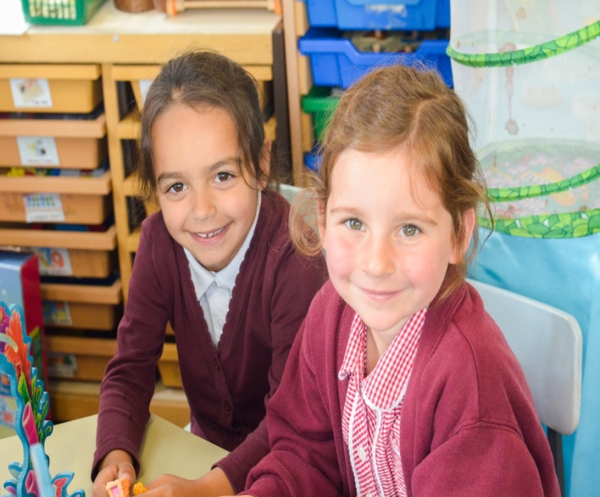
Welcome to Bonneygrove
Reception Induction Information

Slide 2
Bonneygrove Staff
Headteacher – Mrs A Gable
Deputy Headteacher - Mrs A Wilson
Assistant Headteacher - Mr C Bond
Early Years Leader - Mrs V Cain
SENCo - Mrs C Georgiou
School Business Officer - Mrs N Moody

Slide 3
‘Broadening Horizons’
Broadening Horizons represents the schools passion for providing our children with the experiences, skills and attitudes they need to make informed choices.
We believe that our children deserve to be encouraged to be curious and that curiosity leads to debate and a greater understanding of the world.
We encourage our children to aspire to be the best that they can be; we don’t put limits on their learning.
What this Looks Like
In our everyday interactions we enable and seek to extend children’s thinking, we challenge them and inspire them.
We orchestrate experiences that build confidence and show children new things; including language skills, technology and scientific enquiry.
We have classical music that children will become familiar with as well and selecting visits and activities to provide new experiences knowledge and skills.
11 before 11- outlines our schools commitment to broadening horizons.
Our curriculum reflects our aspirations.

Slide 4

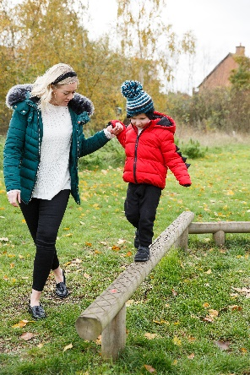
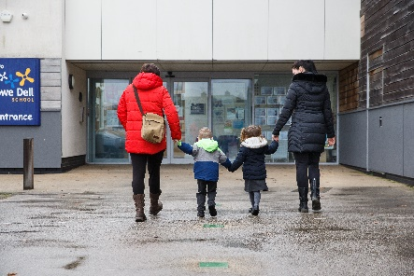
Aims
To give you an overview of
Early Years Foundation Stage (EYFS)
and what your child will be learning
To provide ideas we can effectively work together
and how you can best support your child at home
To help you understand what to
expect from us
Notes:
Insert own school photos
The curriculum for every child under the age of 5
Parents as partners
What this school does specifically – policies, expectations etc

Slide 5
What will my child be learning?
Prime Areas of Learning | Specific Areas of Learning
Personal, Social and Emotional | Literacy
Communication and Language | Mathematics
Physical Development | Understanding the World
 | Expressive Arts and Design
Notes:
Use a piece of video to support discussions about children’s learning in relation to the areas of learning in the EYFS. Either use a video from your school/setting which shows children involved in child-initiated play or use the link to the video below. Ask the parents/carers what they think the children are learning and relate to the Prime and Specific areas of learning to demonstrate learning in the EYFS.
Video link https://www.youtube.com/watch?v=uL3asnZWtyM
The purpose of this is to emphasis learning through play and how high-quality play will involve many of the areas of learning. Explain the adult role’s in supporting and extending learning through play. Emphasise how every child is unique, developing at their own rates, and in their own ways.
Signpost parents/carers to 'What to Expect When' and have some hard copies available for parents to look at and /or loan. https://www.foundationyears.org.uk/wp-content/uploads/2019/01/0778-What-to-Expect-When-2018.pdf

Slide 6
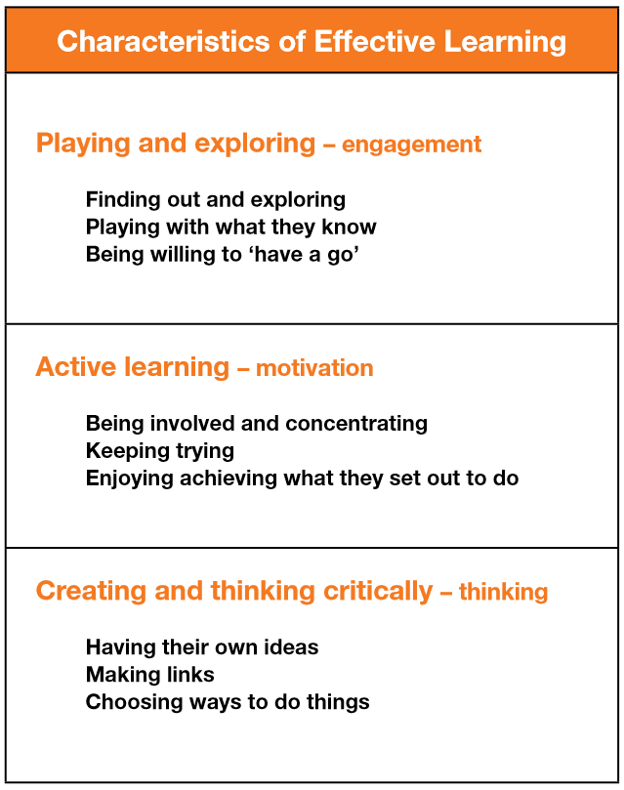
How does my child learn?
Characteristics of Effective Learning
Notes:
School insert own photos
Explain that alongside the Areas of Development we look at the ways in which children learn.
The focus of the CoEL is on how children learn rather than what they learn i.e. process over outcome. This allows for teachers/practitioners to provide the right type of learning opportunities.
Optional to do the following dependent on the needs of your community and parents/carers
Activity - ask the parents to look at the photographs and discuss which of the characteristics of effective learning they think the child/children might be demonstrating.
Alternatively:
Share some of your own photographs and provide examples of how the children are learning through play

Slide 7
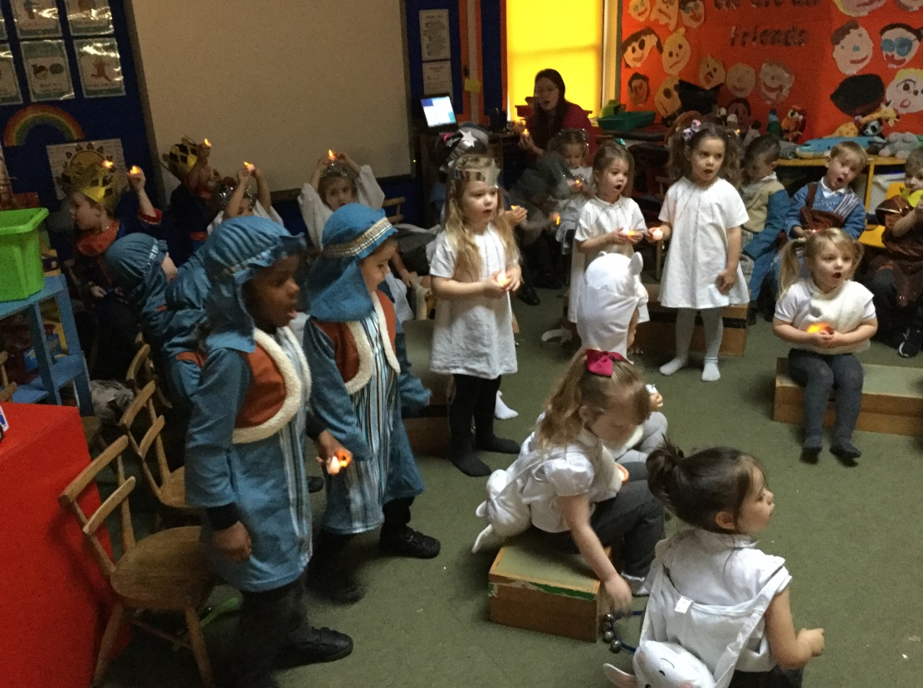
C&L
Communication and Language
Stories
Speaking
Listening
Role play
Singing

Slide 8
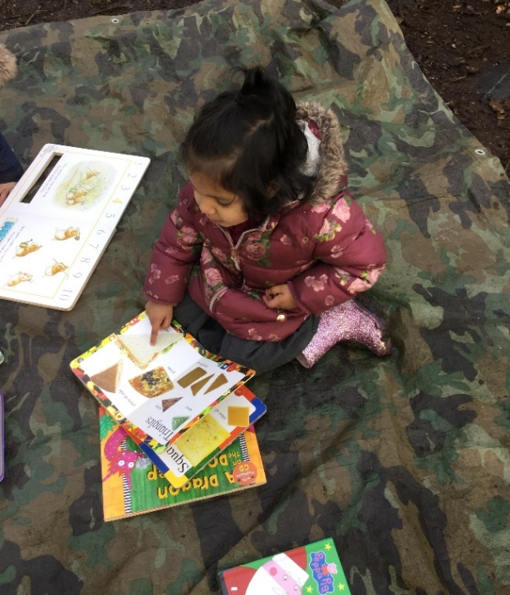
C&L – How you can help?
Singing songs and nursery rhymes.
Taking time to listen to them talking
about things they’ve done and answering
their questions.
Share books together everyday.
Visit the library for story sessions.
Asking for well-known stories to be retold in your child’s own words.

Slide 9
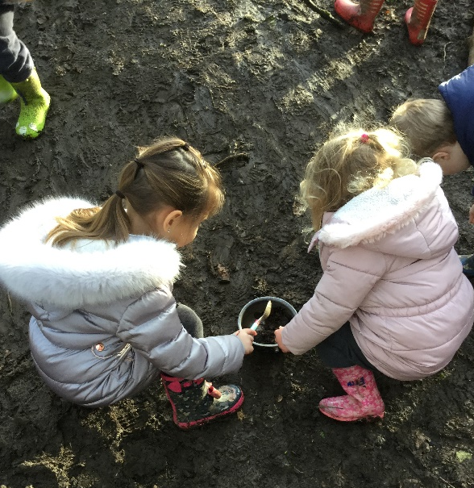
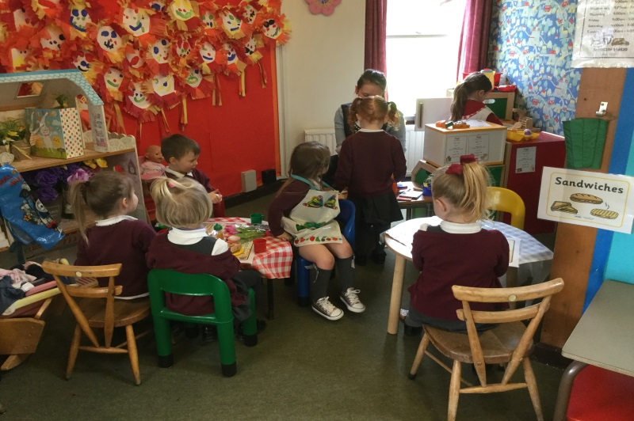
PSED
Personal, Social and Emotional Development
Making friends
Learning rules
Learning daily routines
Learning about other cultures and respect
Understanding boundaries
Making good relationships with adults

Slide 10
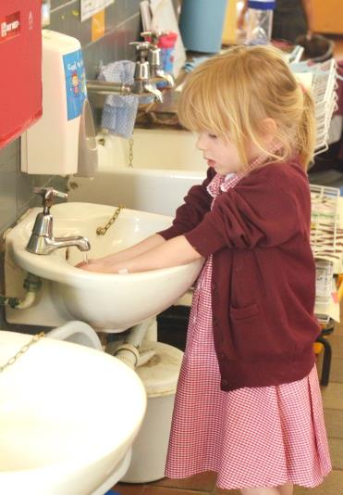
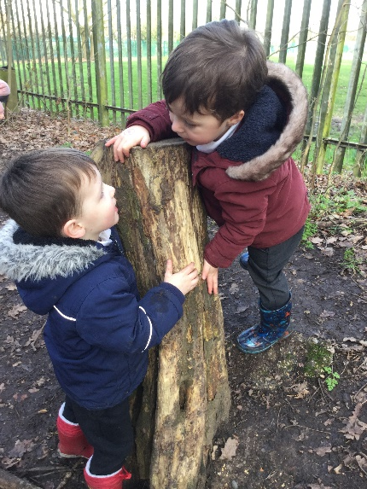
PSED - How can you help?
You can help by encouraging your child to use the toilet independently, and to wash their hands.
Put on and fasten their coats, clothes and shoes.
Eat with a knife and fork.
Playing games which encourage sharing and turn taking will help your child to build their social skills.

Slide 11
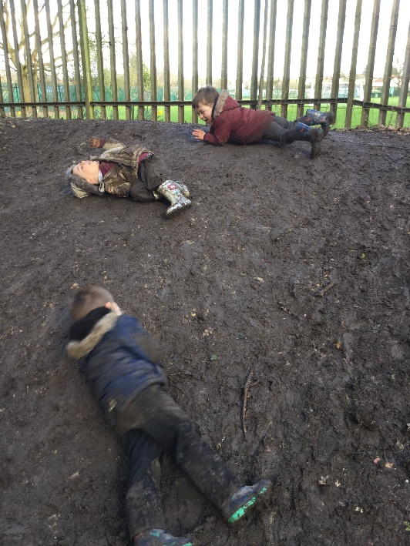
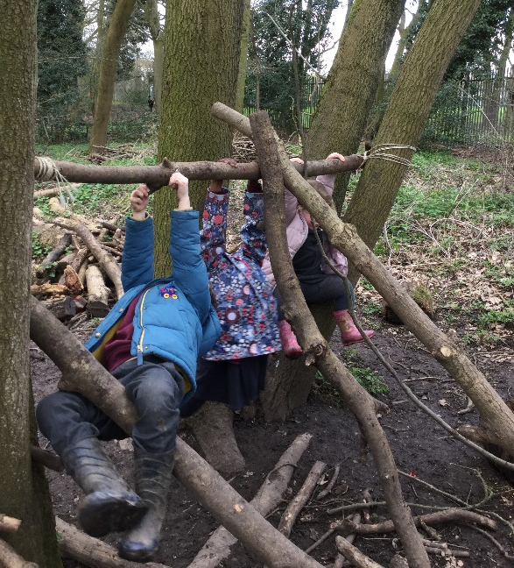
Physical Development
Gross and Fine Motor
Malleable resources (play dough and construction kits)
Fasten shoes and coats
P.E. – getting changed
Outdoor area, tree house climbing frame
Pencil control
ICT navigation

Slide 12
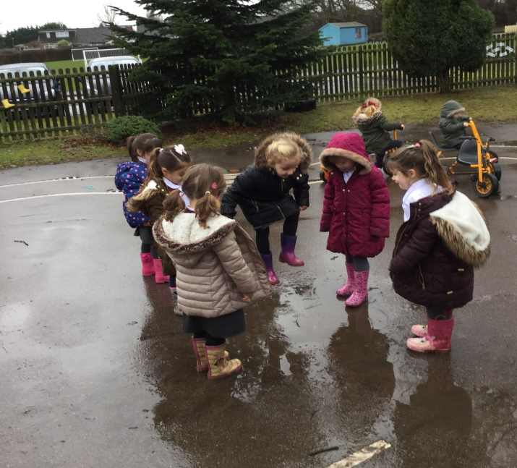
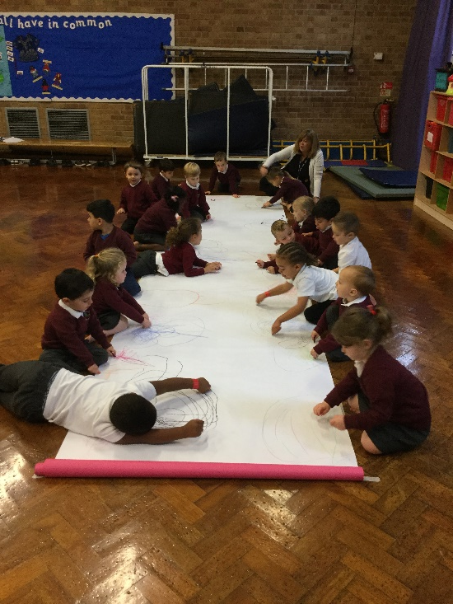
Physical Development
How can you help?
Give children time to run, jump, climb and play outdoors.
Encourage children to take part in activities such as building, drawing, threading beads, or filling and emptying containers in the water.

Slide 13
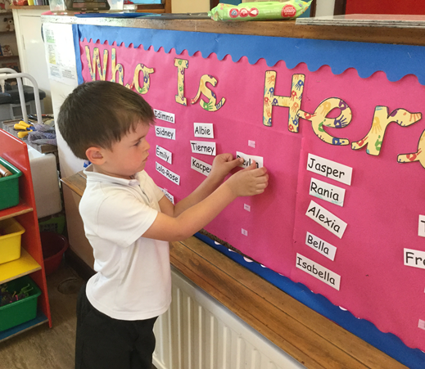
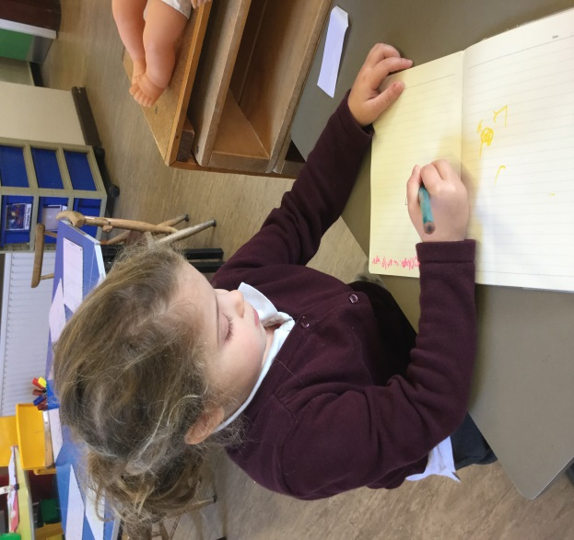
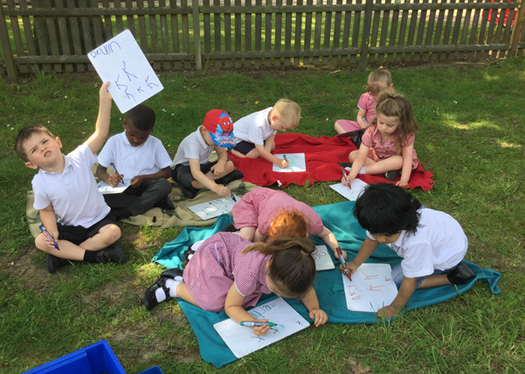
Literacy
Reading and Writing
Phonics (letters and sounds)
Recognising and writing own name
Key reading and writing words
Reading books and labels
Indpendent mark-making.

Slide 14
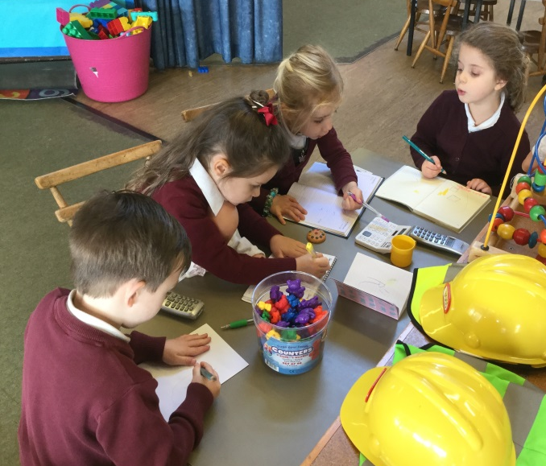
Literacy –
How can you help?
Encourage formation of lower case letters to write name
and all letters of the alphabet.
Reading a range of books (stories, information books,
newspapers, magazines, comics etc), encouraging your
child to join in and talk about books.
Read daily and write comments about your child’s reading in
their school reading diary.
(Please send this in daily).
Teach the letter ‘sounds’ known as
phonemes to blend words together.

Slide 15
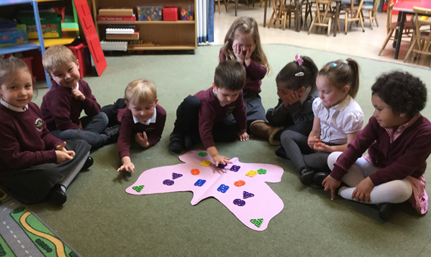
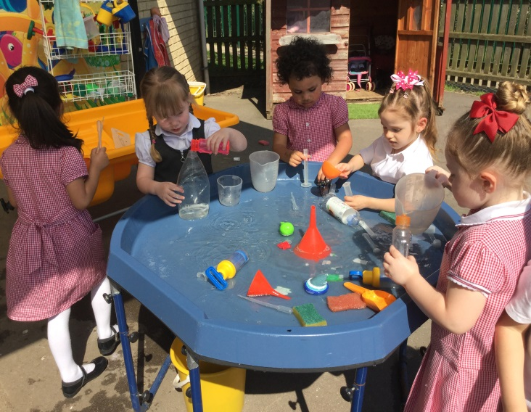
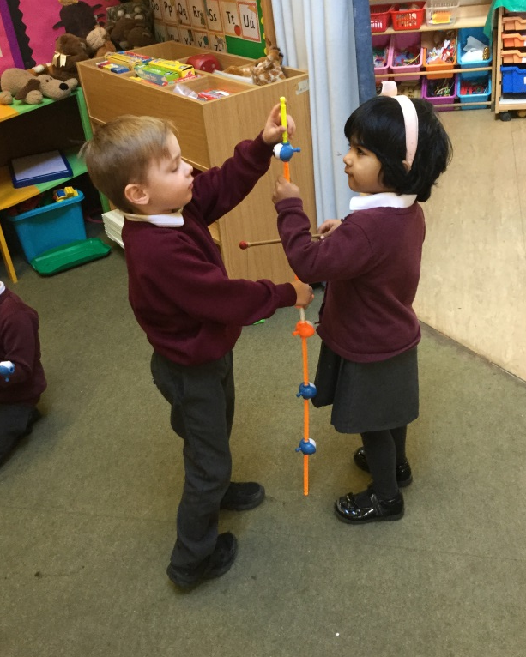
Mathematics
Numbers, Shapes, Space, and Measures
Counting
Recognising numbers and
what they mean
Calculation
Shape
Pattern
Problem solving
Measuring

Slide 16
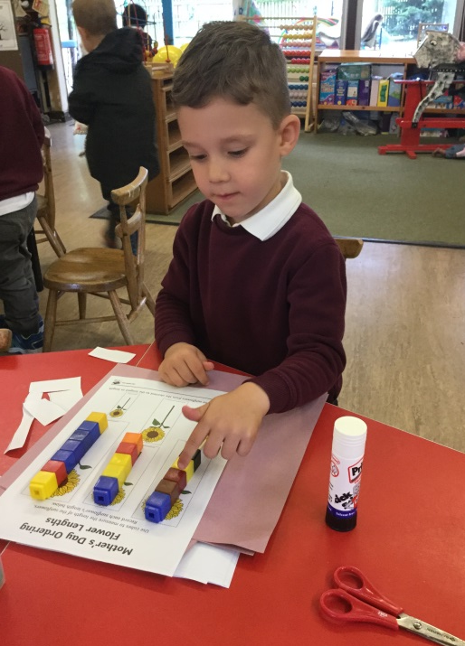
Mathematics–
How can you help?
Talk about the shapes you can see in the environment.
Comparing things which are heavy and light or long and short.
Pointing out numbers all around.
Singing counting songs and rhymes.
Counting, adding and subtracting anything and everything - socks, cars, shopping, cutlery, fingers and toes!

Slide 17
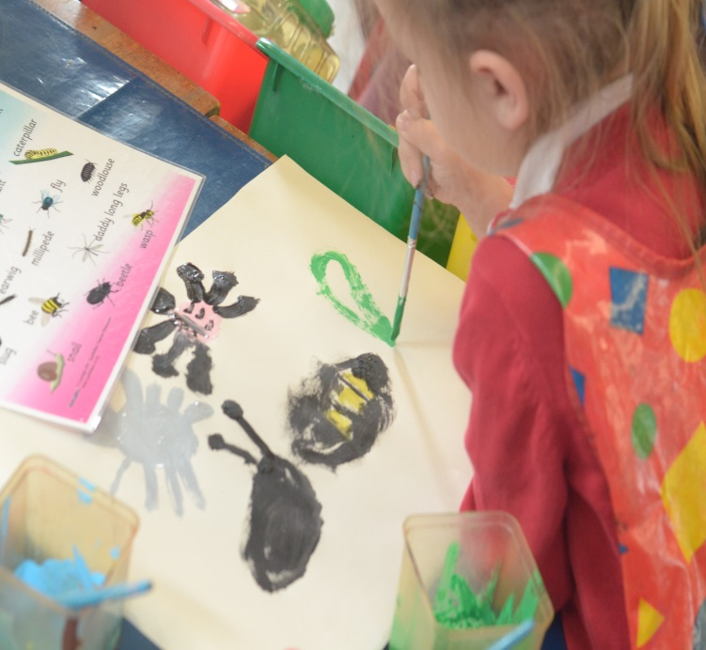
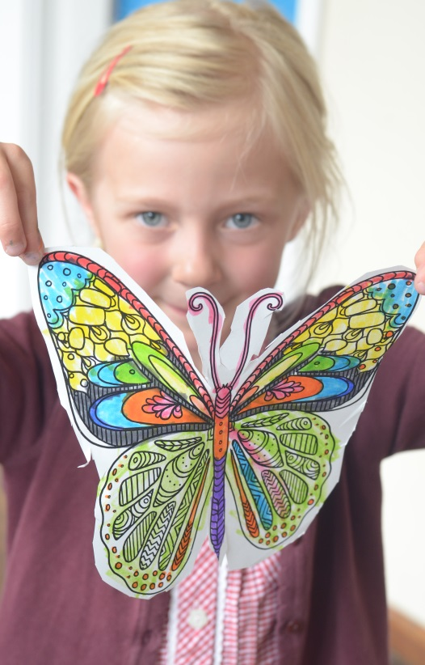
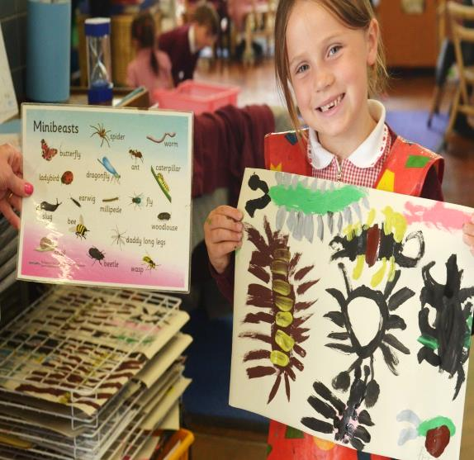

Expressive Arts and Design
Role play
Art
Painting
Drawing
Dance
Music
Singing
Story
Imagination

Slide 18
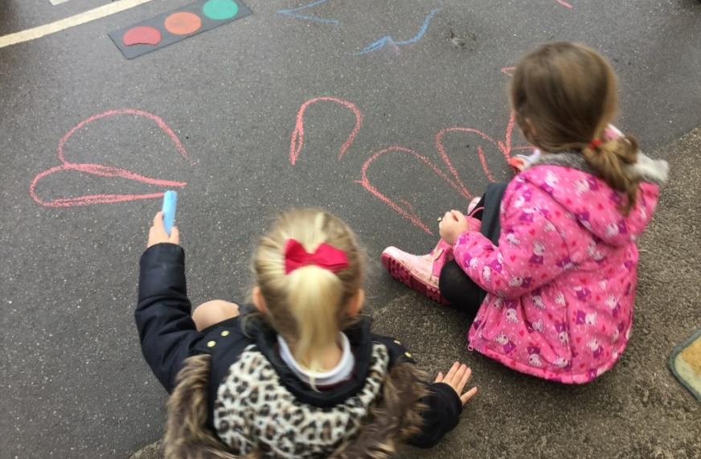
Expressive Arts and Design– How can you help?
Talk with your child about their imaginative play and join in if possible!
Encourage them to be flexible in their thinking and use of materials and praising them for their efforts or ideas as well as the end product.
Singing songs.

Slide 19
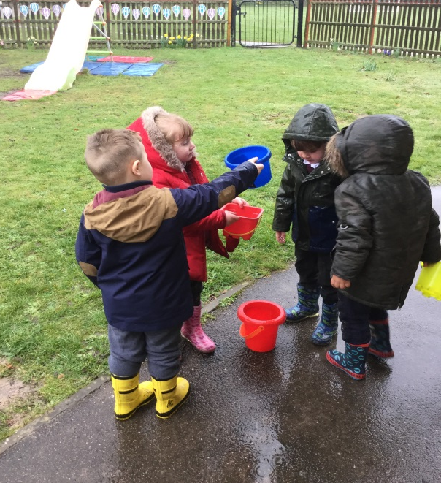
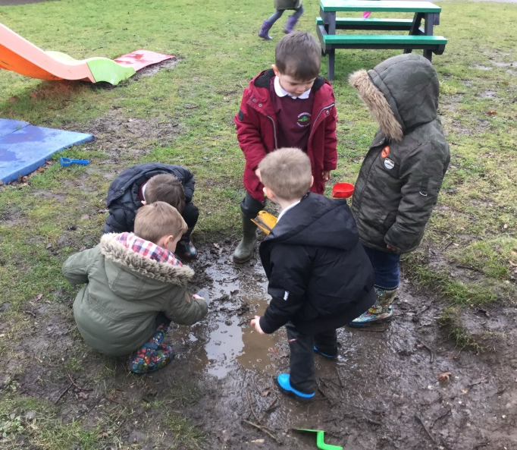
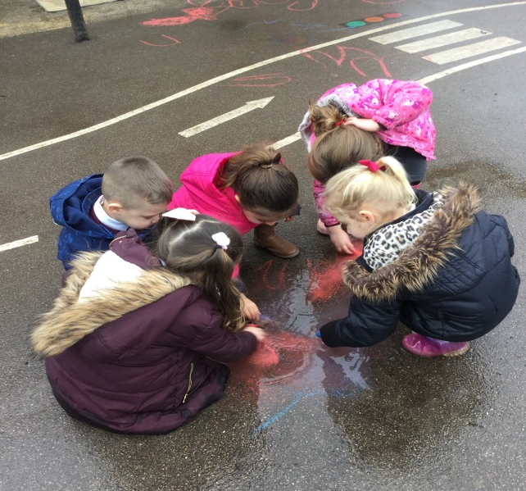
Understanding the World
Exploring
Investigating
Learning about other cultures, places, things that happened in the past
and living things
ICT
Constructing
Educational visits
Outdoors area

Slide 20
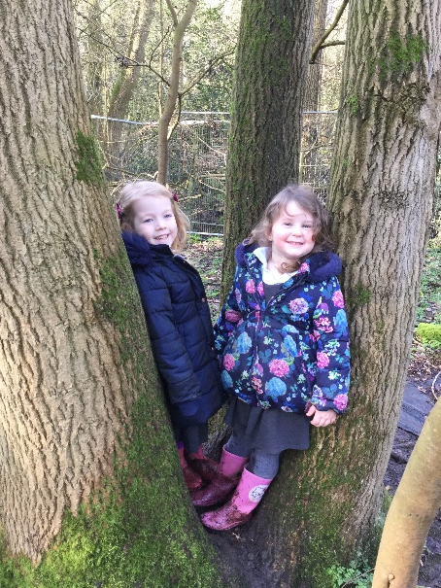
Understanding
the World – How can you help?
Talk with your child about the places they go and things they see in the world around them.
Answering and asking questions - what if…? Why do you think…? How did you…?
Letting children join in with everyday activities - washing up, cooking, shopping, helping in the garden.
Let them have access to ICT,
CD players, mobile phones, tablets,
computers etc

Slide 21
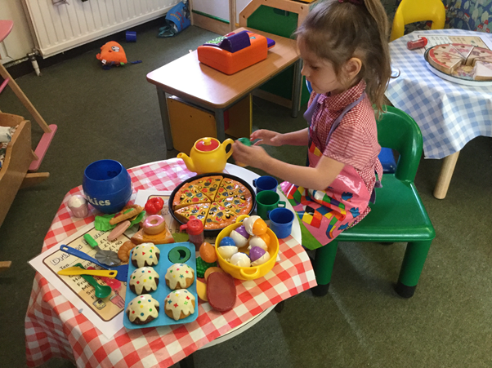
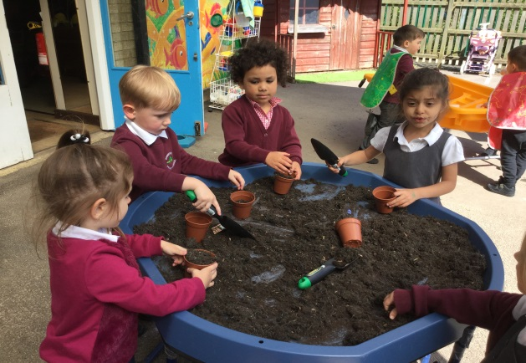
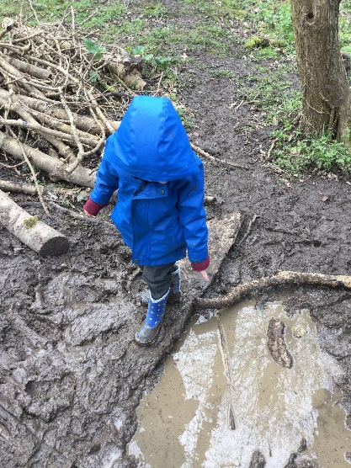
Reception Timetable
Table top activities (FMS)
Register/whole class time
Phonics/reading time
Child Initiated Learning
Snack time
Literacy
Lunch
Maths
Child initiated learning
P.E/woods
Story
Home time

Slide 22
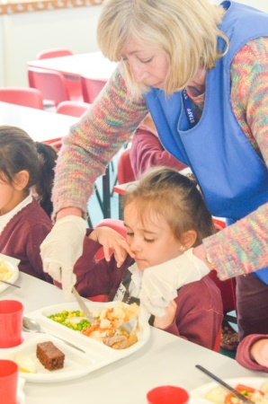
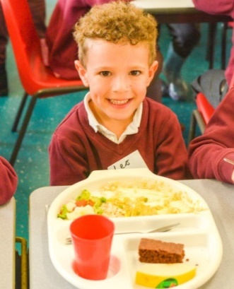
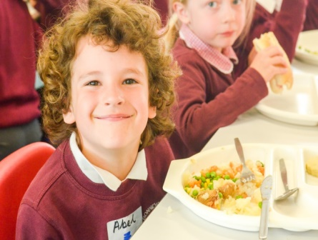
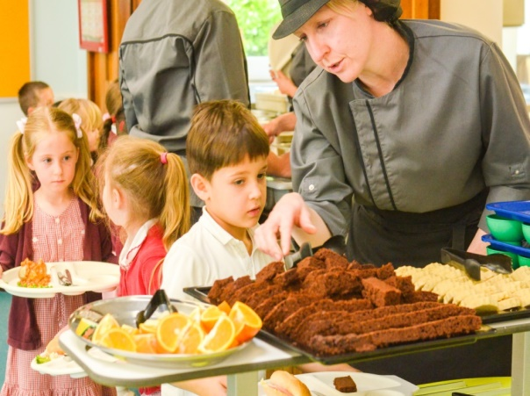
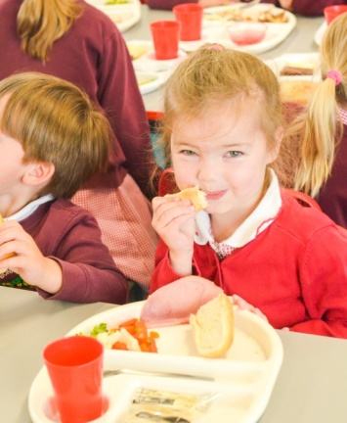
Lunch
You will receive a copy of the school dinner menu twice a year.
Each morning, you will select and record your child’s dinner option on a board outside of the classroom.
Children then choose from a selection of vegetables or salad to accompany their dinner, along with a choice of dessert e.g. cheese & crackers, fruit, home-made pudding.
We encourage children to use cutlery correctly from the beginning by supporting them to cut their own food. Mid-day supervisors are on hand to assist children.

Slide 23
Routines and Procedures
Uniform- please ensure all items of clothing are clearly labelled.
Outdoors – please provide children with wellies that can remain at school as we encourage learning to be outdoors in all weather conditions. Suitable clothing expected to suit all weather conditions.
P.E kit- plain white t-shirt, maroon P.E. shorts, indoor plimsolls. Summer: suitable outdoor trainers. Winter: tracksuit bottoms are accepted. Provide P.E. kit in a labelled, draw string bag (available to purchase from the school office) – they will be returned half termly.
Spare clothes kept in school.
Book Bag (available to purchase from the school office) brought to school every day: key words, reading records + book, letters home, homework.
Hair – long hair tied back. Accessories: small bows, head bands to be in line with Bonneygrove uniform colour (maroon).
Jewellery- small studs only. Tape to be provided for P.E.

Slide 24
Routines and Procedures cont..
Medical – asthma pumps must be in date; they will be stored in the classroom cupboard. An asthma History Questionnaire will need to be completed with the school office before the pump can be accepted.
Collecting children at home time. Children will not be sent home with anyone who is not on their ‘pcik up list’, without permission from parent/ carer.
Wisepay – a log in will be provided once your child is on Roll. Information and payments are made via this method.
Marvellous Me – direct messages from teachers of achievements, curriculum updates and homework badges.
Open sessions – opportunities for parents/carers to enter the classrooms to observe how children learn throughout the year.

Slide 25
Parent Involvement
In order for you to keep up-to-date on how to support learning at home, we like to welcome parents/carers into our classrooms so that you can see how they learn first hand!
Sessions may included: phonics workshops, Harvest Festival, maths workshops.
Nativity play – early December.
Two Parent Consultation sessions (Autumn/Spring)
Sports Day.
End of year report.
Communication is key – feel free to make an appointments to speak to your class teacher.

Slide 26




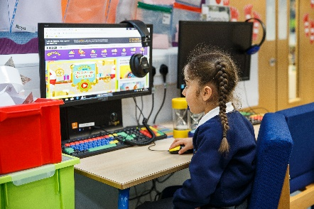

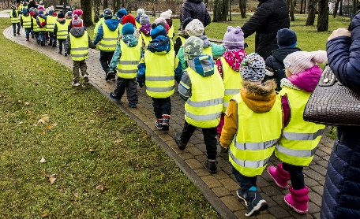
Keeping children safe is everyone’s responsibility
Notes:
Go through each point and give information related to the practice in your school and how you as a school help to keep children safe.
Safeguarding/Child protection Children have a right to be cared for and protected and that protecting them is everyone’s responsibility.
Explain that it is everyone's duty to respond to concerns about a child's safety. All staff are trained and follow procedures in the schools/settings Child Protection policy (copy on the website).
Mobile Phones explain why mobile phones must not be used in school/setting. Talk about why it can be dangerous to share children’s photographs on the internet and your school/setting policy regarding taking photos at school/setting events. Explain how the school/setting keep the children safe when using the internet. Tell parent’s where to find the policy (school/setting website).
Road safety and parking – promote walking to school but if using a car explain safe places to park. Talk about teaching children to cross the road safely.
Drop off and collection procedures - a password is required if unknown adults are collecting. Talk about making sure that gates/doors are closed and ensure that children hold an adult’s hand when leaving the building.
Accidents - explain how the school manage accidents and that first aid is administered in line with the school/setting policy. Talk about the fact that accidents are recorded and how risk assessments are undertaken to manage potential hazards.
Existing injuries - explain that if a child arrives at school/setting with an injury, as part of safeguarding procedures parents/carers will be asked to complete an 'Existing Injury' form.
First Aid – use your school’s First Aid policy to explain how and when you administer first aid. For example, talk about staff being first aid trained and that parents are asked to sign injury forms. Reassure parents that they would be contacted regarding any serious injuries that require further medical attention such as a head injury.

Slide 27


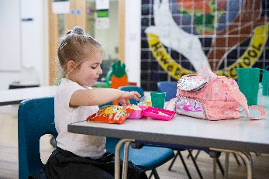


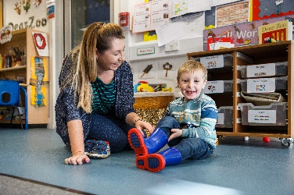
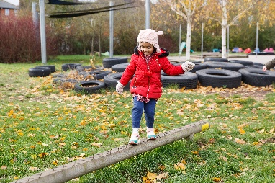


Keeping children safe is everyone’s responsibility
Notes:
Go through each point and give information on how parents/carers can help support the school to keep children safe
Children who are unwell – explain the school policy keep a child off school at least 48 hours after the last attack of vomiting and diarrhea (quote NHS guidelines) informing the school/setting regarding contagious/infectious illnesses
Medication –policy on administering medication (for example, antibiotics or paracetamol) parents/carers responsibility to inform the school if their child is taking or requires any type of medication.
Individual medical needs –vital for parents to share information about their child’s individual medical needs such as allergies so that a Health Care Plan (HCP) can be completed with the parent/carer
Explain the healthy eating policy and share examples of a healthy packed lunch. Remind parents to name lunch bags, containers etc. Talk about arrangements for snack in the early years and whether parents contribute. Explain the school’s procedures for children accessing drinks of water. Talk about the policy regarding bringing in food for a child’s birthday.
Discuss possible allergies and how these are managed in school. For example, a ‘no nut policy.’ Other dietary requirements such as dairy/religious/veganism
Emphasise the importance of regular attendance, 96% attendance expected. Explain how it helps children to have a good routine and that children who attend regularly, settle more easily and make better progress with learning and development.
Children can sometimes be unwell and in which case they need to rest at home.
Explain the school’s/setting’s procedures and policy regarding the parent’s responsibility in alerting the school/setting if a child is absent or if they change address and contact details.
Talk about how parents will be informed about their child’s attendance and any incentives for good attendance (if applicable)
Uniform –what is needed and where it can be purchased, including a book and PE bags (some families new to our education system may not know what is expected). Alert parents to the availability of secondhand uniform. Talk about suitable types of shoes and that all clothing must be named including footwear, coats, scarves and gloves.
Wellington boots –to be kept at school/setting as children play outside in all weathers (including the rain). These must be named.
Outdoor policy - Clothes for cold weather – emphasis the importance of outdoor learning and that that there is no such thing as unsuitable weather just unsuitable clothing. Give examples of appropriate clothing for outdoor play in cold weather.
Clothes for warm weather – explain the school/setting’s sunscreen policy. Advise parents to provide sunhats, cotton clothing that protects the child’s arms. Explain how children have access to drinks of water.
Remind parents that everything needs to be named.

Slide 28



How we communicate with you
Communication is so important. It plays a huge role in ensuring that you are regularly sharing information with us to best support your child.
We do this by…
Daily chats at drop off and pick up time
Termly parent consultation meetings
Stay and Play sessions
Newsletters
Notice board
Social Media – Facebook, Twitter
Email
School Website
Notes:
Edit to suit what is in place in your school/setting
Add your website address, facebook page, twitter account details

Slide 29
General Information
Attendance- we expect children to attend every day. It is important for young children to have a routine and experience all the activities on offer.
Holiday requests – please write to the Headteacher.
Absences - please call the office, before 9.00 a.m., if your child will be absent. If your child has an appointment please let the office know in advance as you will need to sign your child in and out.
Lunches – these are provided by Hertfordshire Catering Ltd and are free to all children in Reception. If you are providing a packed lunch from home, please refer to our healthy eating policy.
. Please complete and return all new starter paperwork by
3rd July 2020 to ensure a smooth transition for your child.

Slide 30
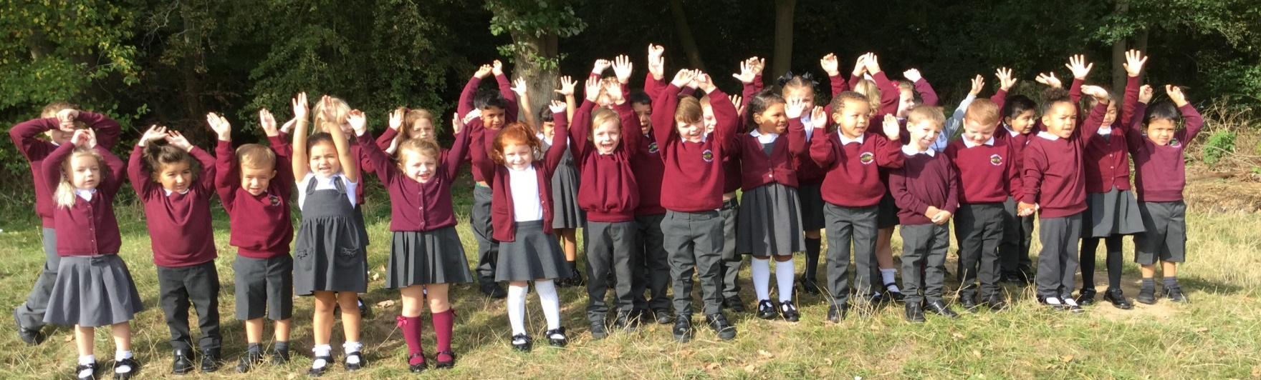
We look forward to working with you!
Please contact the school office if you need any further assistance or have any questions.

