Slide 1

Meet the Teacher 2025/26
Bonneygrove Primary School
Headteacher: Mr Craig Hamilton

Slide 2

Welcome & Introduction
Meet your child’s teacher and classroom team.
Understand what your child will be learning this term.
Find out how to support your child at home.
Opportunity to ask questions.

Slide 3
Daily Routines
School starts promptly at 8:50 am and finishes at 3:15 pm.
Children enter through their designated classroom doors.
PE days and equipment requirements shared in class newsletters – Monday mornings for Year 1
Please ensure all items of clothing are clearly named.
Morning reading routines and collection arrangements.

Slide 4
Learning and Curriculum
Overview of this half term’s Curriculum Newsletter.
Focus on Reading, Writing, Maths, and wider curriculum subjects.
Phonics and spelling in KS1; grammar and structured writing in KS2.
Engaging, creative, and practical topic-based learning.
Assessment and feedback to guide progress.

Slide 5
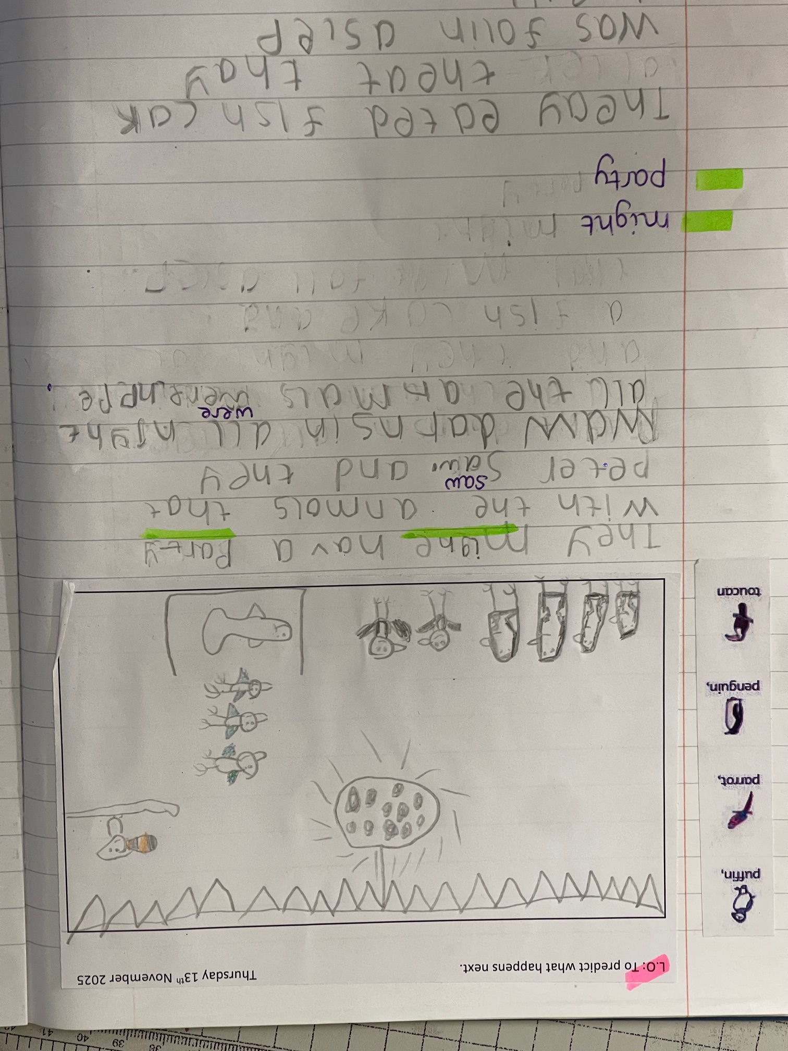
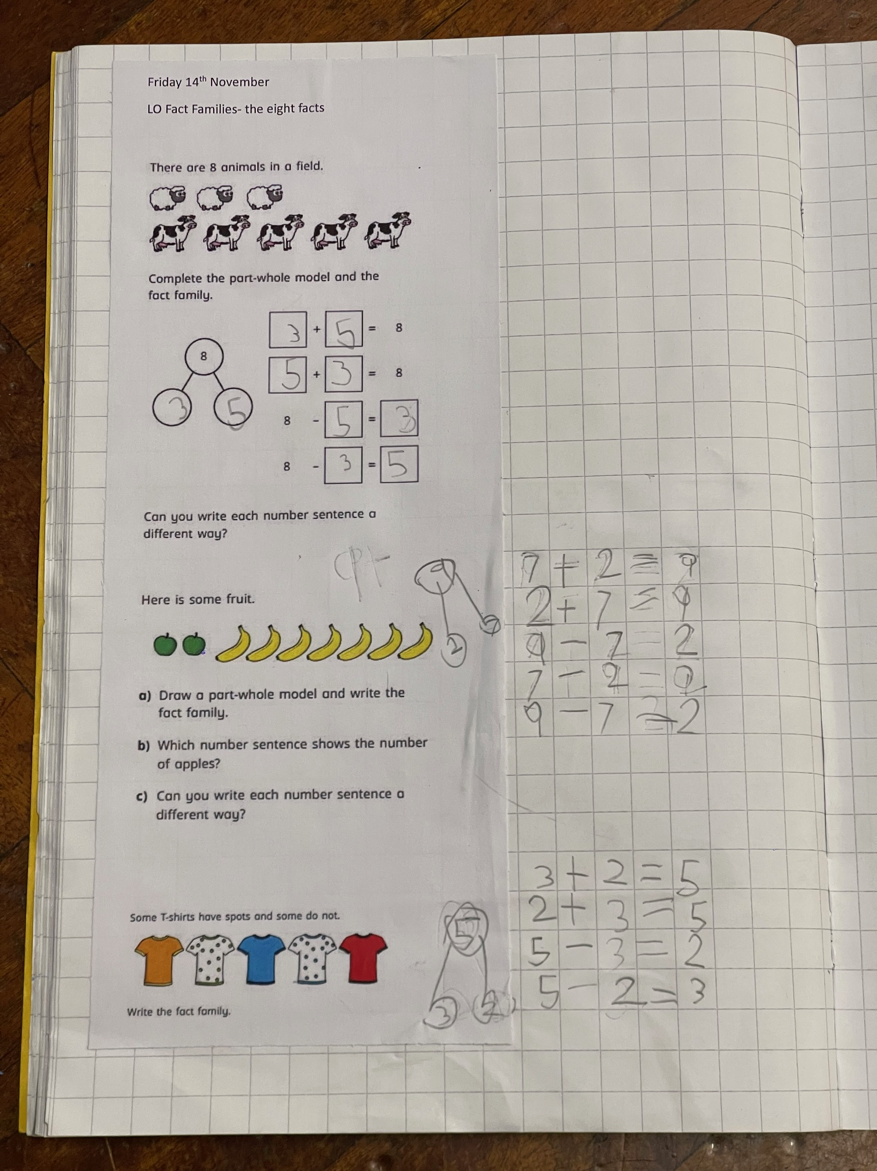

Slide 6
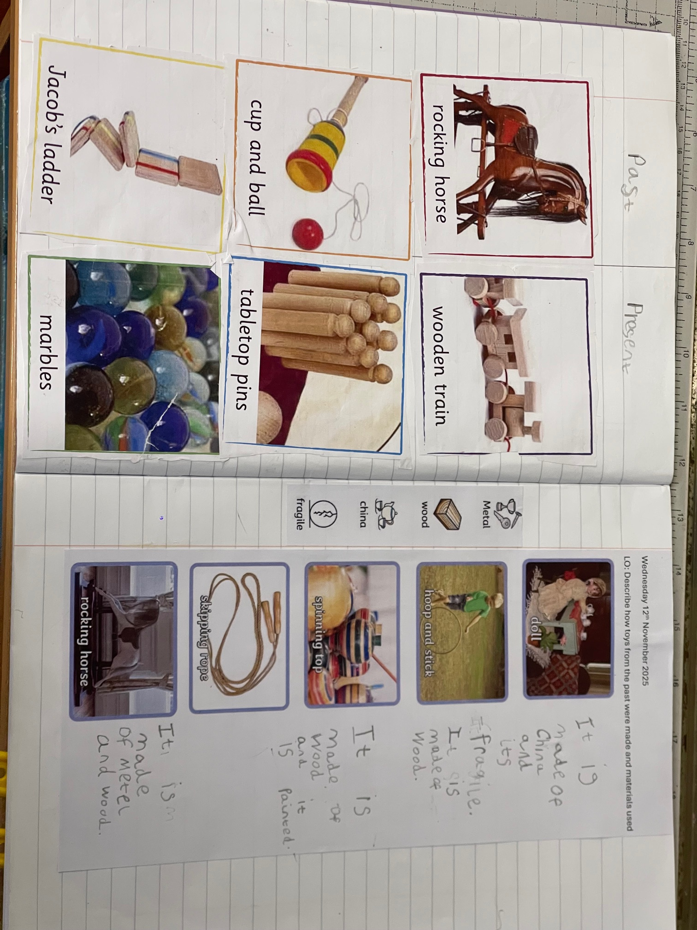

Slide 7
Homework and Reading
Weekly homework set on Thursdays, due back on the following Thursday.
Reading books sent home on a Friday, to be returned the following Thursday. If you do not return your physical book, we are unable to give another new one.
Reading at least four times a week – record in the reading record.
Children will be able to choose a reading book from their class library at the weekly “book bonanza”, this can go home and needs to be returned the following Tuesday.
Weekly phonics task and Maths task for homework.
Encouragement for reading for pleasure at home.
Optional creative or research-based homework projects.

Slide 8
Behaviour and Expectations
Bonneygrove Values: Respect, Responsibility, Kindness, and Resilience.
Positive reinforcement and reward systems in all classes.
Clear routines for listening, learning, and participation.
High expectations for behaviour, attendance, and punctuality.

Slide 9
Communication
Teachers available briefly at drop-off and collection times.
Appointments for longer discussions via the school office.
Weekly newsletters shared via email and the school website.
Key dates and trip information provided in advance.

Slide 10
Year Group Focus
Years 1–2: Building confidence in reading, writing, and number fluency.
Years 3–4: Developing independence and deeper understanding.
Years 5–6: Preparing for secondary transition and leadership roles.

Slide 11
Questions and Discussion
Please feel free to ask questions about routines, curriculum, or support.
Thank you for your continued partnership in your child’s education.

