Slide 1

Meet the Teacher 2025/26
Bonneygrove Primary School
Headteacher: Mr Craig Hamilton

Slide 2

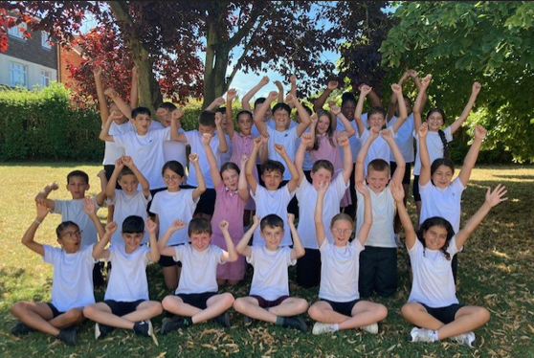
Welcome & Introduction
Meet your child’s teacher and classroom team.
Understand what your child will be learning this term.
Find out how to support your child at home.
Opportunity to ask questions.

Slide 3
Daily Routines
School starts promptly at 8:50 am and finishes at 3:15 pm.
Children enter through their designated classroom doors.
PE days and equipment requirements shared in class newsletters (but generally on Monday and Wednesday)
Please ensure all items of clothing are clearly named.

Slide 4
Daily Routines
Children complete early morning work – this is usually a Read for 20 but could be Maths or SPaG revision or finishing work from previous day.
After registration, children then move to their morning groups for Guided Reading, English and Maths.

Slide 5
Learning and Curriculum
Overview of this half term’s Curriculum Newsletter.
Focus on Reading, Writing, Maths, and wider curriculum subjects.
Phonics and spelling in KS1; grammar and structured writing in KS2.
Engaging, creative, and practical topic-based learning.
Assessment and feedback to guide progress.

Slide 6
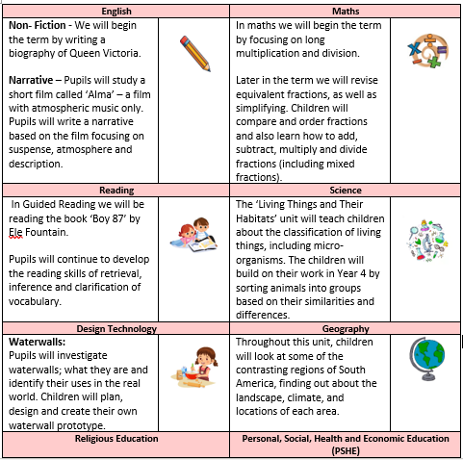
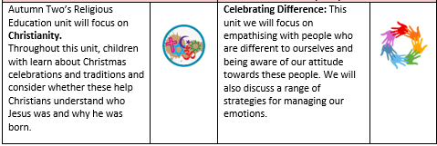
Overview of this half term’s Curriculum Newsletter.

Slide 7
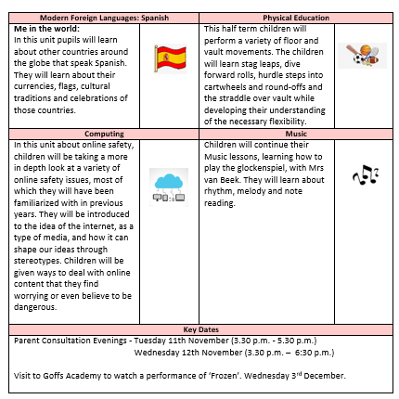

Slide 8
Homework and Reading
Weekly homework set on Thursdays, due back on the following Thursday.
Reading at least four times a week – record in the reading record.
Weekly spellings or times-table practice tasks.
Encouragement for reading for pleasure at home.
Optional creative or research-based homework projects.

Slide 9
Behaviour and Expectations
Bonneygrove Values: Respect, Responsibility, Kindness, and Resilience.
Positive reinforcement and reward systems in all classes.
Clear routines for listening, learning, and participation.
High expectations for behaviour, attendance, and punctuality.

Slide 10
Communication
Teachers available briefly at drop-off and collection times.
Appointments for longer discussions via the school office.
Weekly newsletters shared via email and the school website.
Email : yearsix @bonneygrove.herts.sch.uk

Slide 11
Key dates and trip information.
SATS information evening – Thursday 12th February 2026 5:00 – 5:30pm
IOW information evening – Thursday 19th March 2026 5:00 – 5:30pm
IOW trip – Friday 10th July – Monday 13th July
London Theatre Trip – Wednesday 20th May 2026
We will return around 6:00 - 6:30pm
Year 6 Prom - Tuesday 7th July 2026 6:30 – 8:30 pm
Year 6 Presentation evening and BBQ - Thursday 16th July 2026 6:00 – 8:00 pm
Year 6 end of year performance – Wednesday 15th July 2026 9:30-11:30 am / 6:00 – 7:30 pm

Slide 12
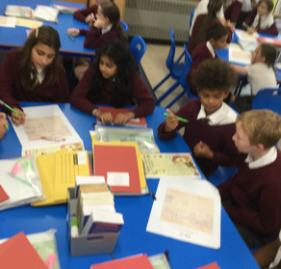
Year Group Focus
Years 1–2: Building confidence in reading, writing, and number fluency.
Years 3–4: Developing independence and deeper understanding.
Years 5–6: Preparing for secondary transition and leadership roles.

Slide 13
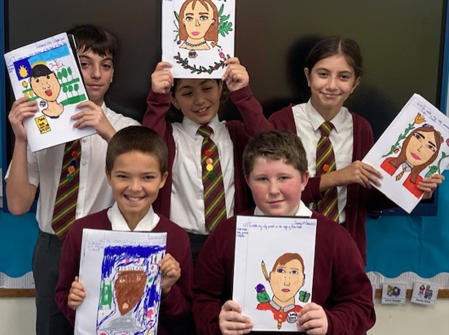
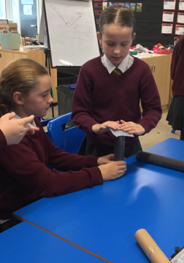
Questions and Discussion
Please feel free to ask questions about routines, curriculum, or support.
Thank you for your continued partnership in your child’s education.

