Slide 1

Meet the Teacher 2025/26
Bonneygrove Primary School
Headteacher: Mr Craig Hamilton

Slide 2

Welcome to Year Two
Dahl Class: Miss Doyle
Wilson Clas: Mrs Patel

Slide 3
Daily Routines
School starts promptly at 8:50 am and finishes at 3:15 pm.
Children enter through their designated classroom doors.
PE days (Thursday) and equipment requirements shared in class newsletters Please ensure all items of clothing are clearly named.
Morning reading routines and collection arrangements.

Slide 4
Learning and Curriculum
Overview of this half term’s Curriculum Newsletter.
Focus on Reading, Writing, Maths, and wider curriculum subjects.
Phonics and spelling in KS1; grammar and structured writing in KS2.
Engaging, creative, and practical topic-based learning.
Assessment and feedback to guide progress.

Slide 5
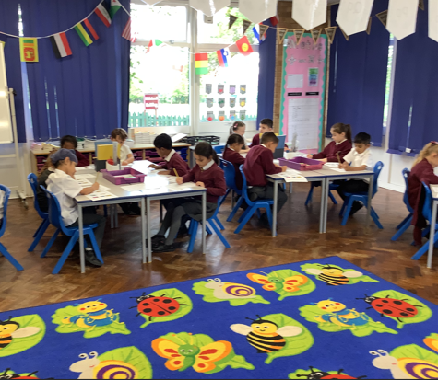
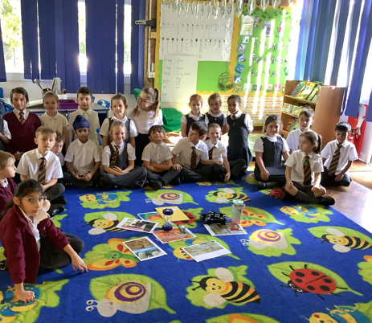
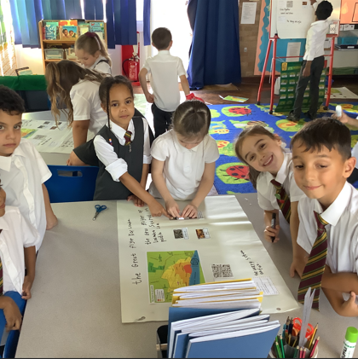
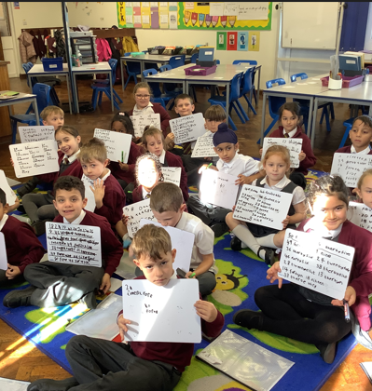
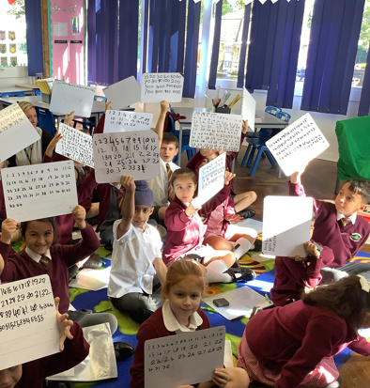

Slide 6
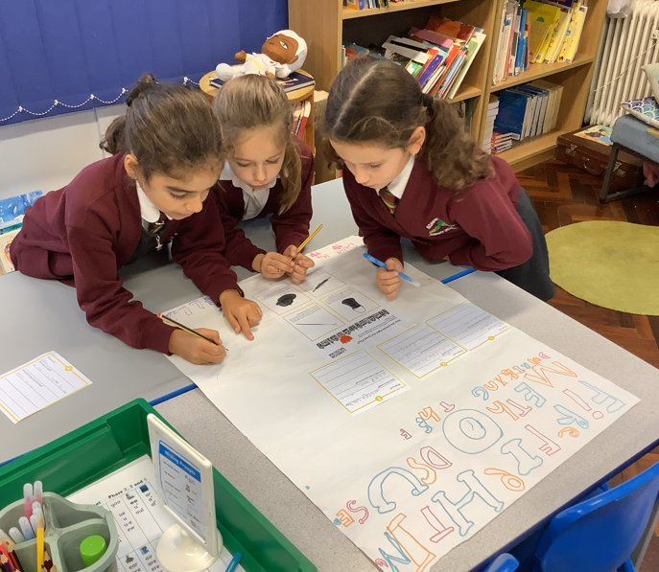
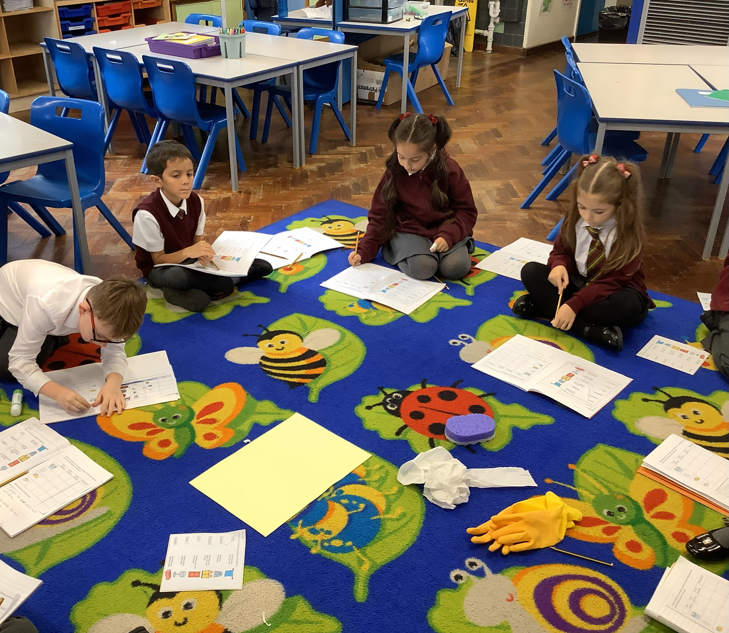
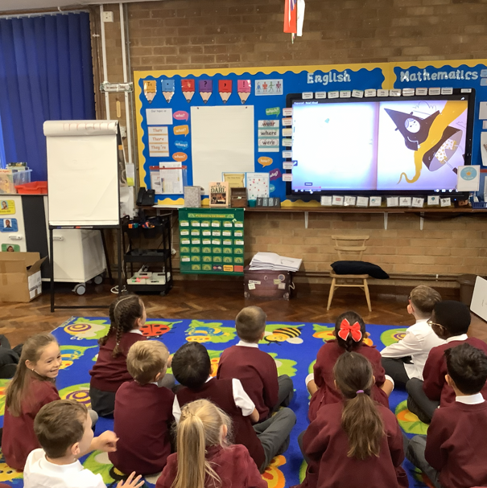
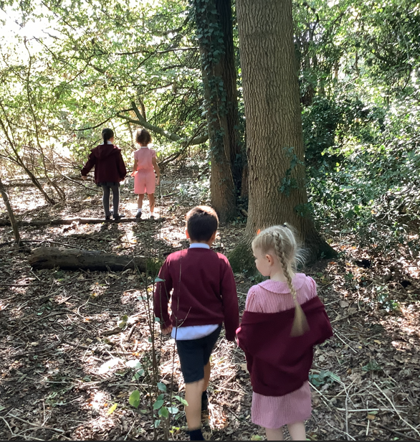
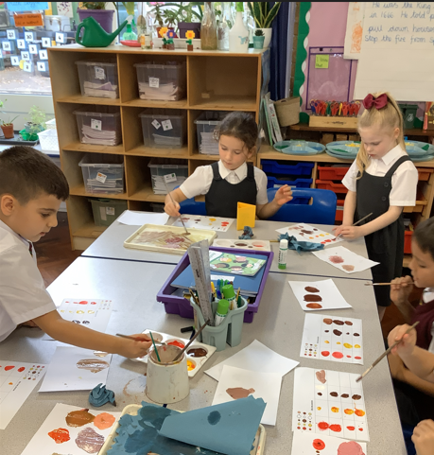

Slide 7
Homework and Reading
Weekly homework set on Thursdays, due back on the following Thursday.
Reading at least four times a week – record in the reading record.
Weekly spellings or times-table practice tasks.
Encouragement for reading for pleasure at home.
Opportunities for creative or research-based homework projects.

Slide 8
How you can help further at home
Maths
Practise number bonds to 20
Practise times tables (TT Rock Stars)
- Ask your children every day problems involving money, time, measures, etc.
Reading
Listen to your child read regularly to improve fluency.
Support with sounding out words and blending sounds together.
Ask them questions using inference to check understanding
Writing
Provide opportunities for your child to write , perhaps about days out or other experiences.
Practise spelling all common exception words learnt to date.

Slide 9
Behaviour and Expectations
Bonneygrove Values: Respect, Responsibility, Kindness, and Resilience.
Positive reinforcement and reward systems in all classes.
Clear routines for listening, learning, and participation.
High expectations for behaviour, attendance, and punctuality.

Slide 10
School Uniform
The uniform must be school colours: grey trousers/shorts/skirts/pinafore or checked red and white gingham dress for summer. Burgundy V-neck jumper or cardigan, and a white long or short-sleeved shirt with a clip on tie. Further information can be found on website.
All children should be in plain black footwear (trainers acceptable)
There should be no logos on the jumpers or shirts, other than the Bonneygrove logo.
All clothing should be clearly named.
Trousers should be smart – no jogging bottoms (except for Reception).
We encourage children to take responsibility for looking after their own property.

Slide 11
Communication
Teachers available briefly at drop-off and collection times.
Appointments for longer discussions via the school office.
Weekly newsletters shared via email and the school website.
Key dates and trip information provided in advance.

Slide 12
Year Group Focus
Years 1–2: Building confidence in reading, writing, and number fluency.
Years 3–4: Developing independence and deeper understanding.
Years 5–6: Preparing for secondary transition and leadership roles.

Slide 13
Questions and Discussion
Please feel free to ask questions about routines, curriculum, or support.
Thank you for your continued partnership in your child’s education.

