Slide 1

Isle of Wight
Friday 10th July – Monday 13th July

Slide 2
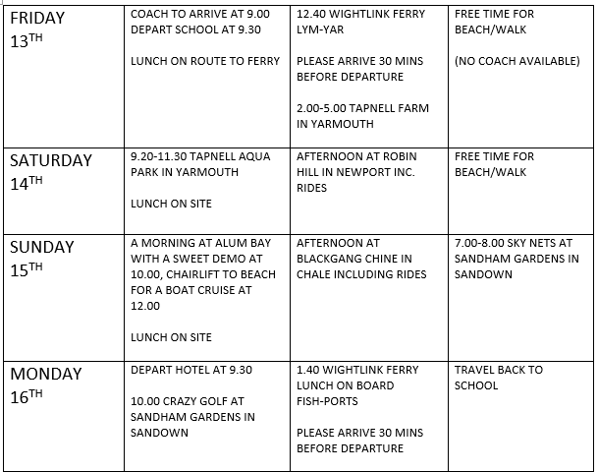
Itinerary
Please note:
This is last year’s itinerary (we have yet to finalise this year’s but it will be similar)

Slide 3
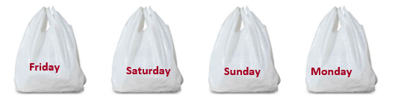
Kit List
You will need:
Waterproof coat/anorak
Solid flat shoes e.g., trainers
Sweatshirt/jumper
T-shirts
Smarter outfits for evenings e.g., jeans and polo shirt or dress
Underwear
Swimming Costume and Towel
Socks
Pyjamas
Sun hat
Sun cream
Shower towel
Toiletries including: toothbrush, toothpaste, soap, shampoo, hairbrush
Up to £10 to spend at gift shop (optional)
Disposable camera (optional)
No electronics
All prescribed medication, including an inhaler, should be given to Miss Wylie prior to the trip and a medicine form should have been filled in.

Slide 4
Food and Sleeping Arrangements
Children will select a sandwich filling that they would like for packed lunches for the duration of the trip. These will be prepared daily for us to take with us on our outings.
Each morning at breakfast they will be given two dinner options to choose from e.g. pizza or burger. At dinner time, they will choose their breakfast for the following day e.g. scrambled eggs on toast or a sausage sandwich. There will also be a variety of cereals available for breakfast, as well as salad at dinner time.
Children will share rooms in groups of 2, 3, 4, 5 or 6. These will vary and will depend on the children that they have asked to share with. We will ensure that there will be at least one of their friends in their room.

Slide 5
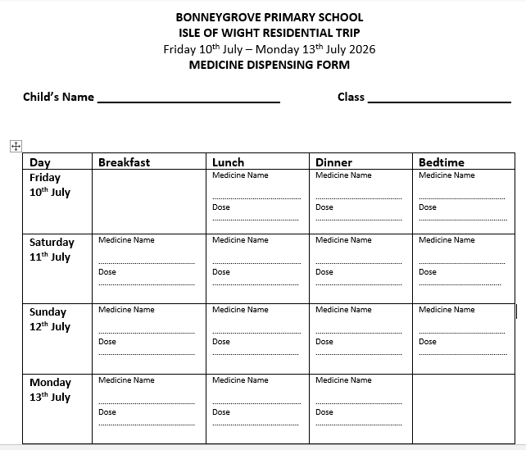
Medication

Slide 6
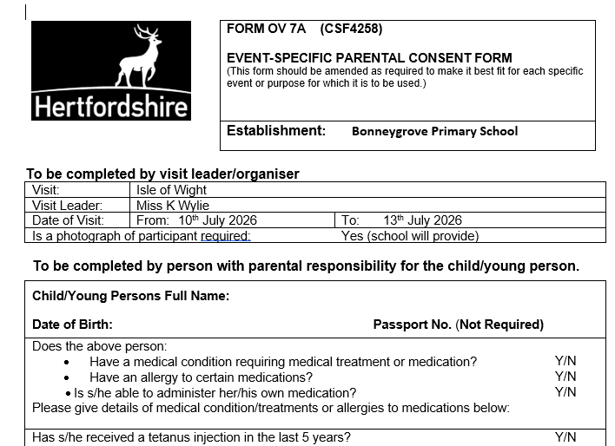
Consent form

Slide 7
Gentle reminder…
An instalment of £81 is due at the end of March.
Full payment is due by the end of April.

Slide 8
Any Questions?

