Slide 1


Welcome to Bonneygrove Primary School Reception!

Slide 2


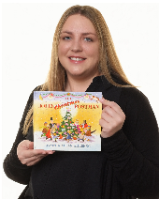
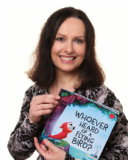
Bonneygrove Primary School Staff
Executive Headteacher
Mr Hamilton
Head of School
Miss Hurry
Head of Inclusion
Miss Stevens
Acting Assistant
Early Years Lead
Mrs Photi

Slide 3

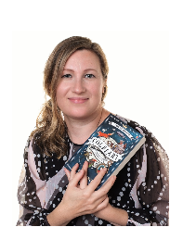
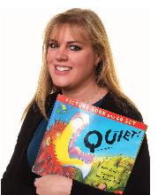

Bonneygrove Primary School Staff
Miss Morris
Reception Teacher
Mrs Darrington
Reception Teacher
Mrs Nobrega
Reception TA
Mrs Kipkebut
Reception TA

Slide 4
What will my child be learning?
Prime Areas of Learning | Specific Areas of Learning
Personal, Social and Emotional | Literacy
Communication and Language | Mathematics
Physical Development | Understanding the World
 | Expressive Arts and Design
Notes:
The Specific Areas of Learning cannot be developed alone and rely on the skills gained in the Prime Areas of Learning.
PSED – self regulation, managing self and building relationships
C+L – Speaking and listening – attention – back and forth conversation
Physical development – Fine and gross motor
We are learning through play. Explain the adult role’s in supporting and extending learning through play. Emphasise how every child is unique, developing at their own rates, and in their own ways.

Slide 5
Reception Timetable
8.35 – 8.50 – Early morning activity as children arrive
8.50 – 9.00 – Register
9.00-9.30 – Phonics
9.30 – 10.00 – Child Initiated Learning
10.00-10.10 – Snack
10.10 – 11.00 –Child Initiated Learning
11.00-11.30 – Topic/ Talk for Writing
11.30-11.45 – Story / get ready for lunch
11.45-12.55 – Lunch time
12.55-1.00 – Register
1.00 – 1.25 – Maths
1.25 – 2.45 – Child Initiated Learning
2.45 – 3.00 – Phonics
3.00 – 3.15 – Story time
3.15 – Home time
Guided reading 3 x per week
PE / Visit to the woods once per week

Slide 6
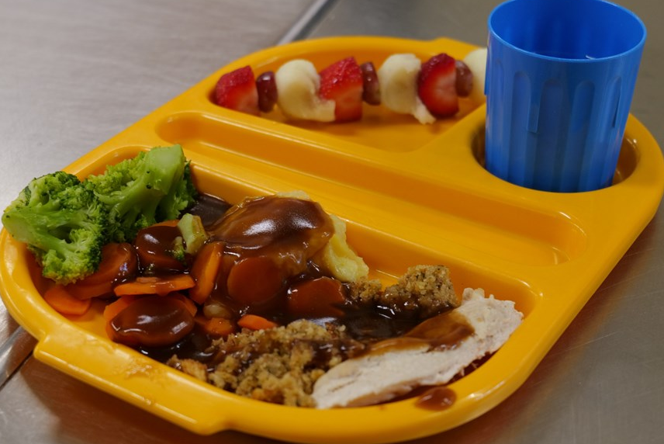
Lunch
Every child in Reception and KS1 is entitled to a free school meal.
You will receive a copy of the school dinner menu.
You will select your child’s lunch choices for the week on Arbor
Children will choose from a selection of vegetables or salad to accompany their dinner, along with a choice of dessert
We encourage children to use cutlery correctly from the beginning by supporting them to cut their own food. Mid-day supervisors are on hand to assist children.

Slide 7
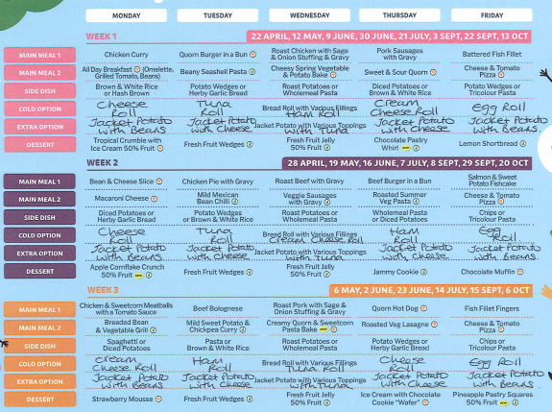

Slide 8
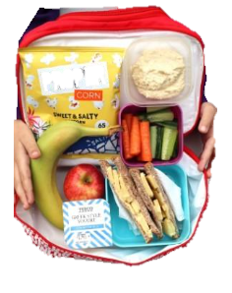
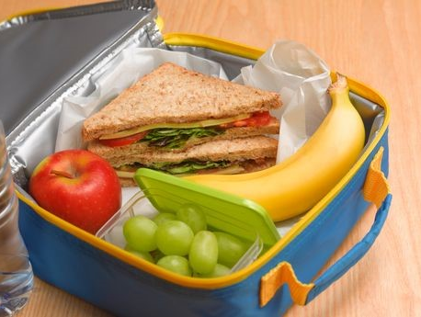
Packed Lunch
You can choose for your child to bring a packed lunch instead of a school dinner.
Notes:
A sandwich / something substantial
A piece of fruit
A healthy snack
Yoghurt
Explain the healthy eating policy and share examples of a healthy packed lunch. Remind parents to name lunch bags, containers etc. Talk about arrangements for snack in the early years and whether parents contribute. Explain the school’s procedures for children accessing drinks of water. Talk about the policy regarding bringing in food for a child’s birthday.

Slide 9

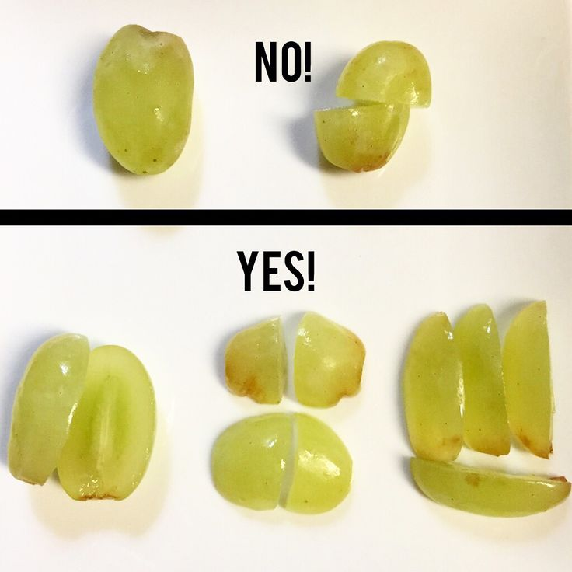


Notes:
Discuss possible allergies and how these are managed in school. For example, a ‘no nut policy.’ Other dietary requirements such as dairy/religious/veganism

Slide 10
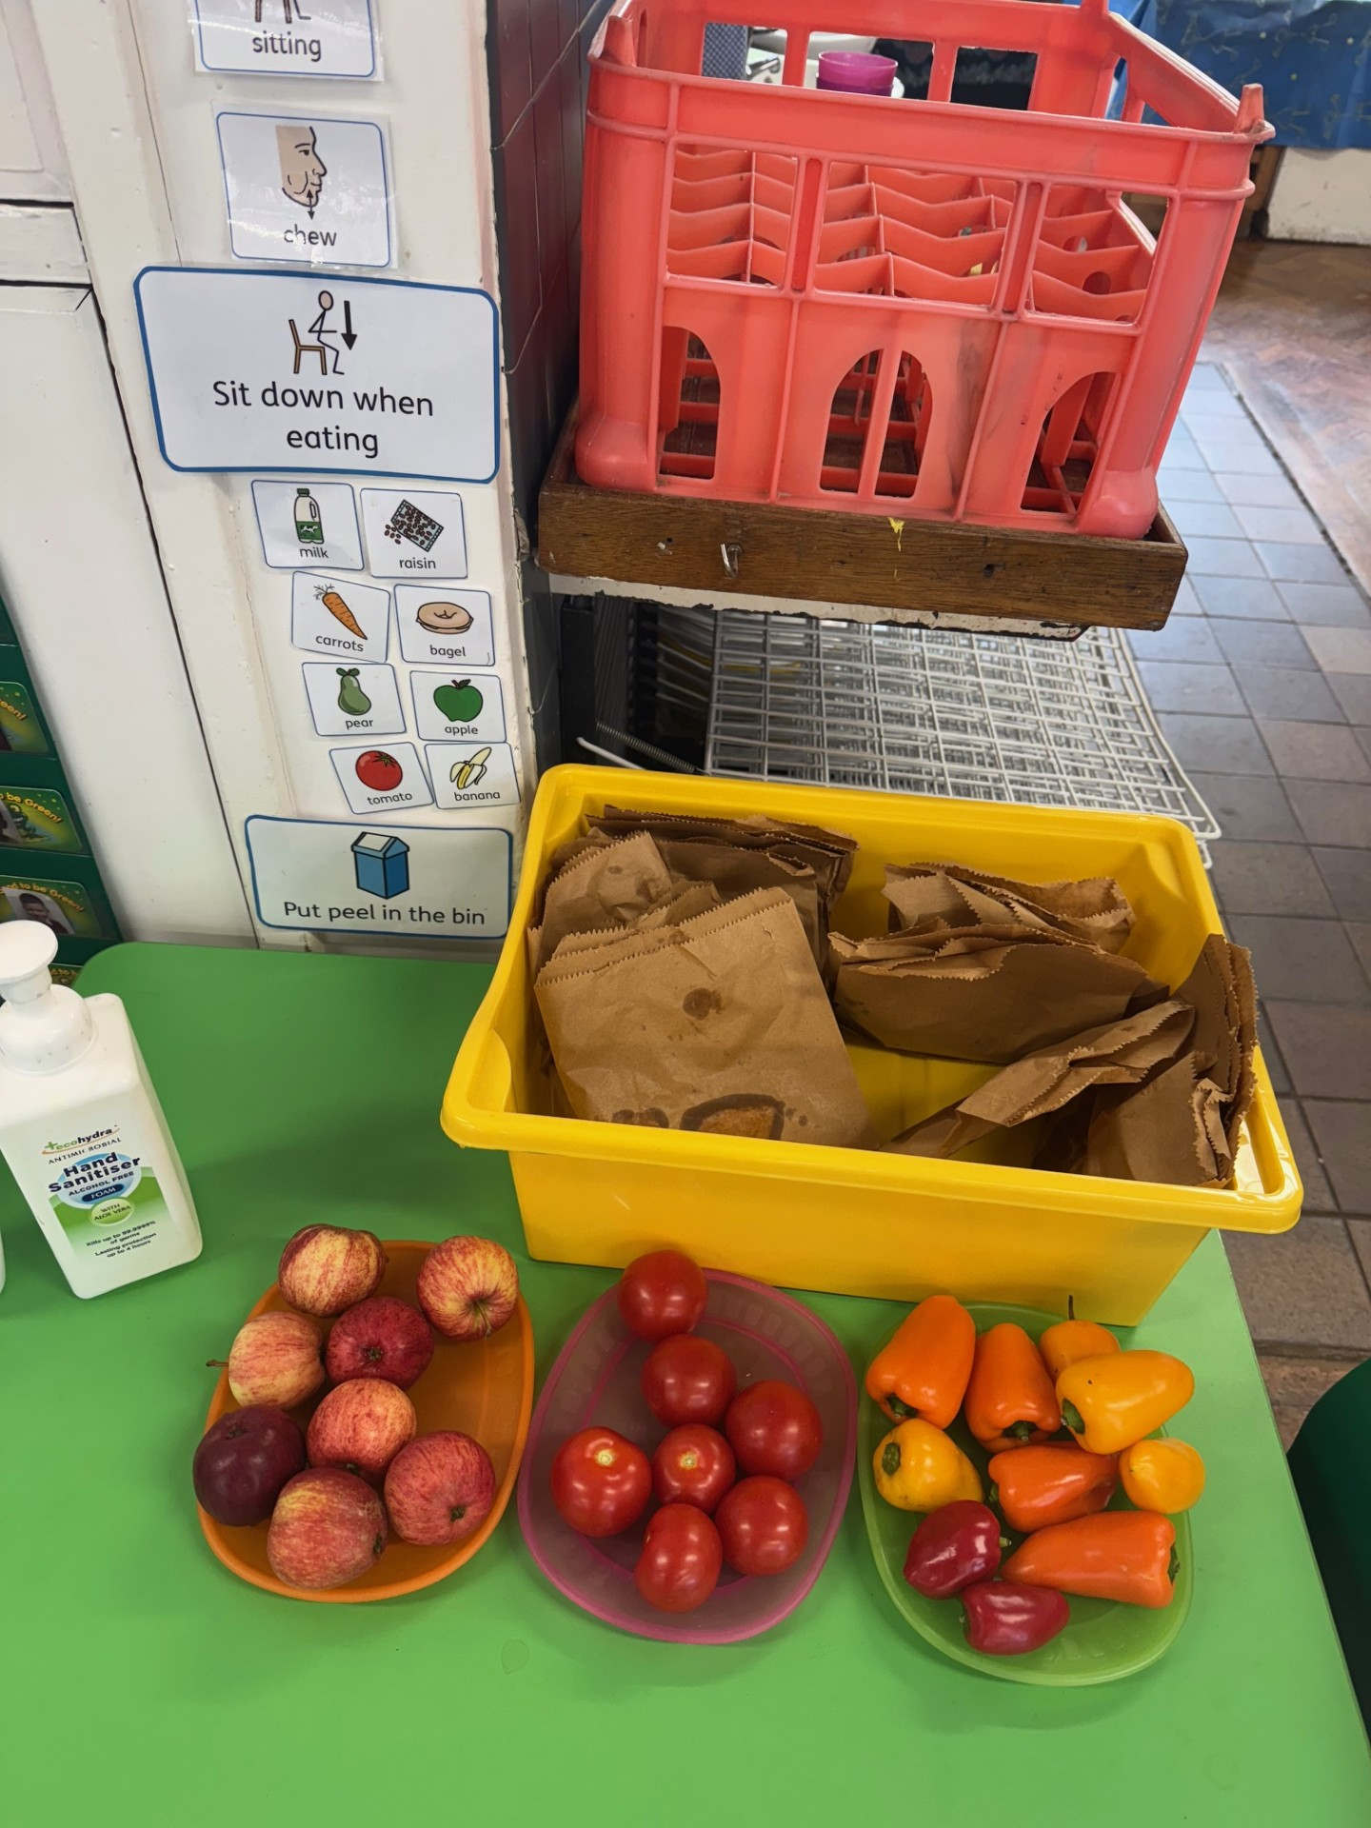


SNACK
Fruit is available daily
Bagels are available most days
Milk available and free to all children under 5 Years
(can be purchased after that)

Slide 11


Water bottles
Ensure your child has a NAMED water bottle with them every day.
These are available for children to help themselves throughout the day.

Slide 12
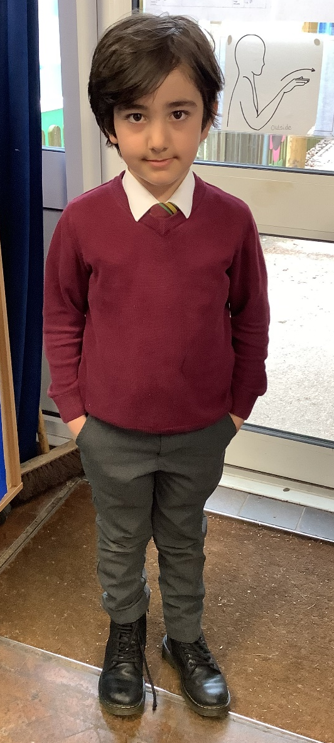
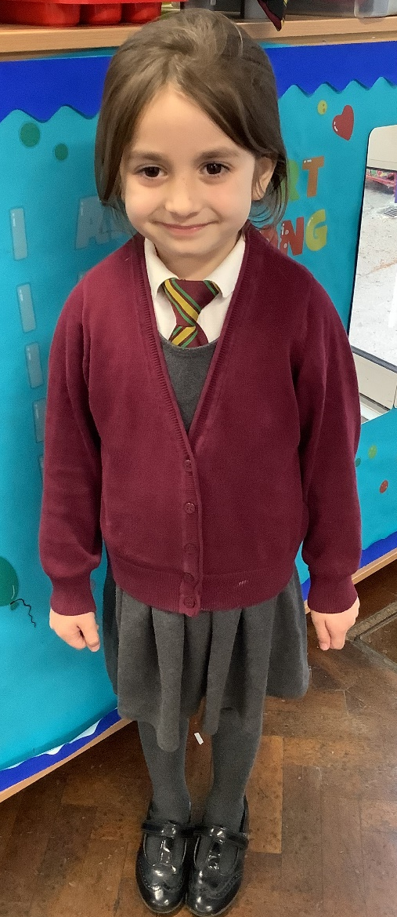
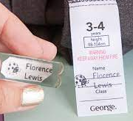
uniform
Burgundy v neck jumper or cardigan
Grey skirt
Grey / black trousers / jogging bottoms
White long or short sleeved shirt with clip on tie
Black footwear.
PLEASE LABEL UNIFORM

Slide 13
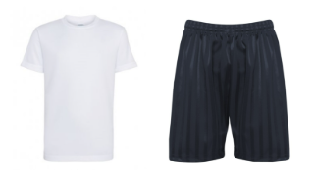
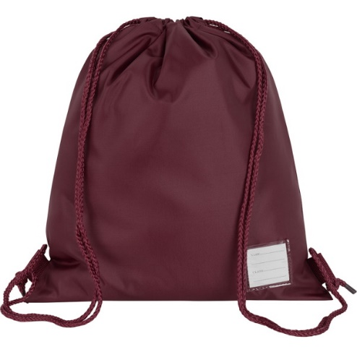
PE KITS
Plain white t-shirt,
black P.E. shorts,
trainers (Velcro please)
Winter: tracksuit bottoms
Provide P.E. kit in a labelled, draw string bag
– they will be returned half termly.
PLEASE
LABEL

Slide 14
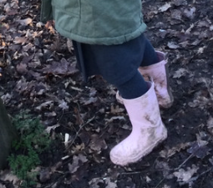

EXTRAS
Wellies - Please provide children with wellies that can remain at school as we encourage learning to be outdoors in all weather conditions. Suitable clothing expected to suit all weather conditions.
Book Bag (available to purchase from the school office) brought to school every day: key words, reading records + book, letters home, homework. Please no rucksacks!
Spare clothes- Please provide children with a bag of spare clothes that they can change into should they need to.

Slide 15
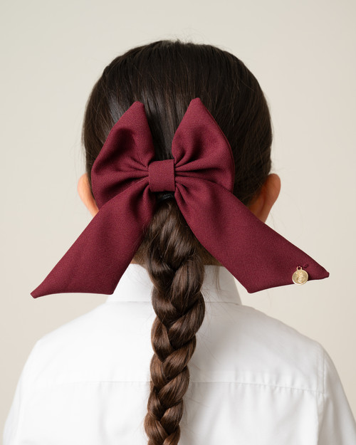
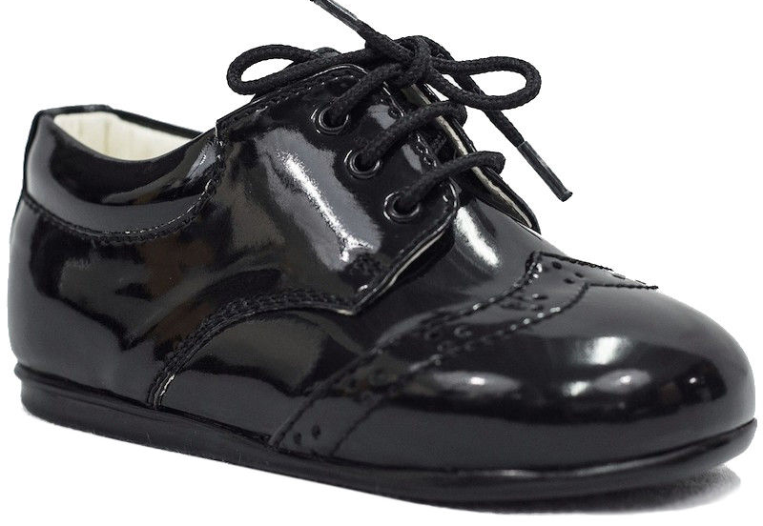
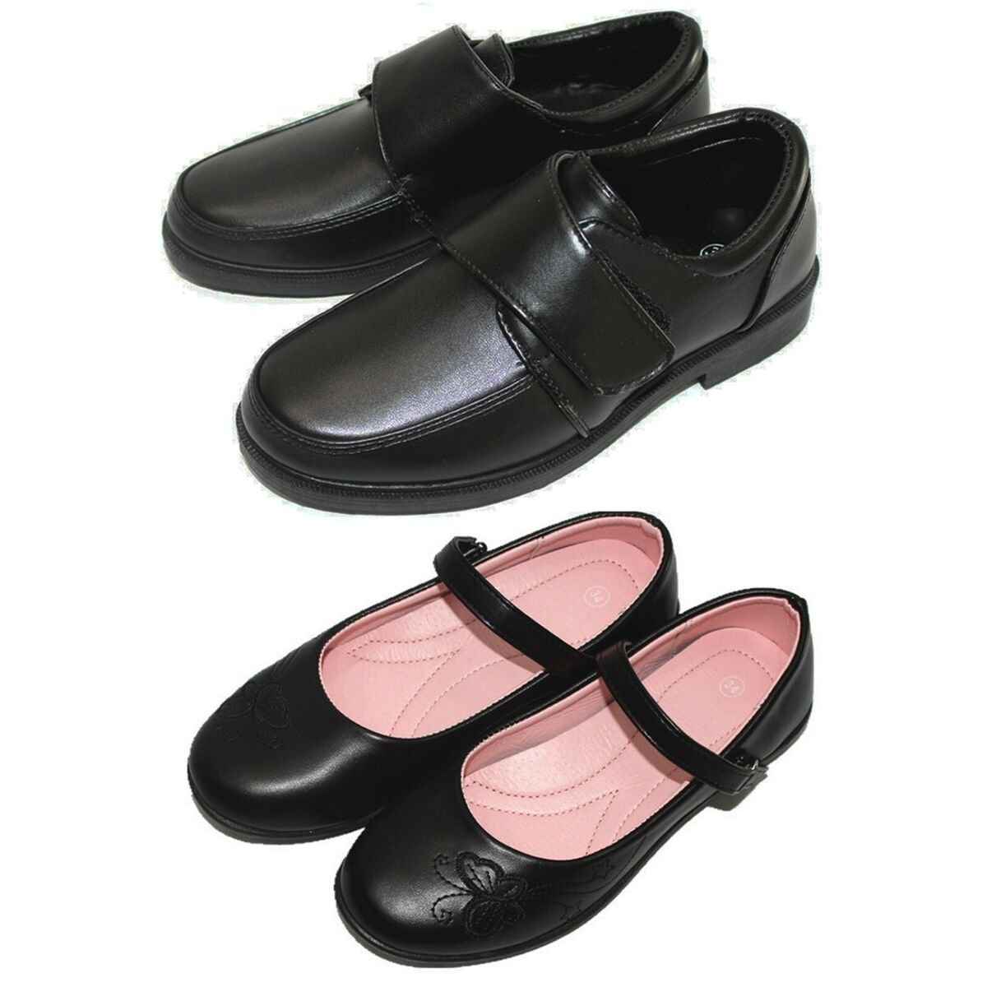

Hair – long hair tied back. Accessories: small bows, head bands to be in line with Bonneygrove uniform colour (burgundy).
Shoes- A sensible pair of hard-wearing school shoes. (Please no laces )
No laces please

Slide 16


Medical – asthma pumps must be in date; they will be stored in the classroom cupboard. An asthma History Questionnaire will need to be completed with the school office before the pump can be accepted.
Collecting children at home time. Children will not be sent home with anyone who is not on their ‘pick up list’, without permission from parent/ carer.
Arbor – a log in will be provided once your child is on Roll. Information and payments are made via this method.

Slide 17
attendance
We expect children to attend every day. It is important for young children to have a routine and experience all the activities on offer.
Holiday requests – please write to the Headteacher.
Absences - please call the office, before 9.00 a.m., if your child will be absent. If your child has an appointment, please let the office know in advance as you will need to sign your child in and out.
Notes:
Emphasise the importance of regular attendance, 96% attendance expected. Explain how it helps children to have a good routine and that children who attend regularly, settle more easily and make better progress with learning and development.
Children can sometimes be unwell and in which case they need to rest at home.

Slide 18
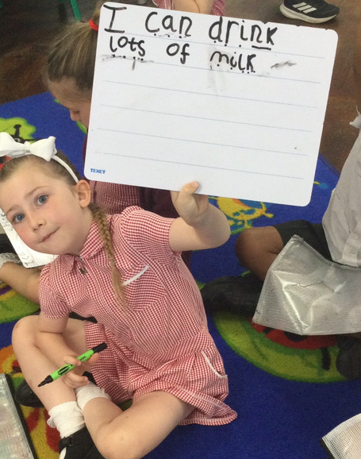
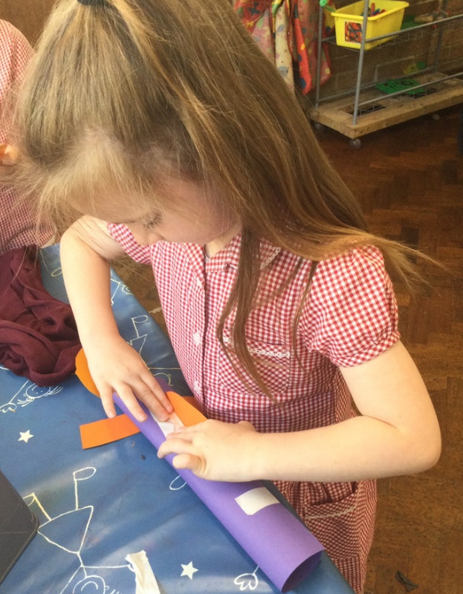
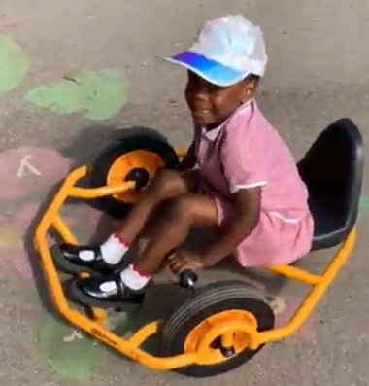

tapestry
Tapestry – online learning journals . Logins given at the end of term.

Slide 19
Parent Involvement
We like to welcome parents/carers into our classrooms as much as possible, so that you can see how your children learn first-hand! Sessions may include: phonics workshops, book bonanzas or themed days.
Reading record
Nativity – early December.
Trips and Visits
Two Parent Consultation sessions (Autumn/Spring)
Sports Day
End of year report
Communication is key – feel free to make an appointments to speak to your class teacher.

Slide 20
How we communicate with you
Communication is so important. It plays a huge role in ensuring that you are regularly sharing information with us to best support your child.
We do this by…
Daily chats at pick up time
Termly parent consultation meetings
Termly Newsletters
Notices on classroom window
Social Media – Facebook, Instagram (@ bonneygroveps)
Tapestry
School Website
Notes:
Edit to suit what is in place in your school/setting
Add your website address, facebook page, twitter account details

Slide 21


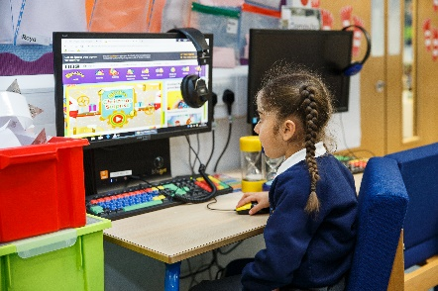

Keeping children safe is everyone’s responsibility
Notes:
Safeguarding/Child protection Children have a right to be cared for and protected and that protecting them is everyone’s responsibility.
Explain that it is everyone's duty to respond to concerns about a child's safety. All staff are trained and follow procedures in the schools/settings Child Protection policy (copy on the website).
Mobile Phones explain why mobile phones must not be used in school/setting. Talk about why it can be dangerous to share children’s photographs on the internet and your school/setting policy regarding taking photos at school/setting events. Explain how the school/setting keep the children safe when using the internet.
Road safety and parking – promote walking to school but if using a car explain safe places to park. Talk about teaching children to cross the road safely.
Accidents - explain how the school manage accidents and that first aid is administered in line with the school/setting policy. Talk about the fact that accidents are recorded and how risk assessments are undertaken to manage potential hazards.
First Aid –explain how and when you administer first aid. For example, talk about staff being first aid trained. Reassure parents that they would be contacted regarding any serious injuries that require further medical attention such as a head injury.

Slide 22
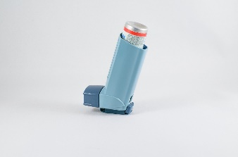

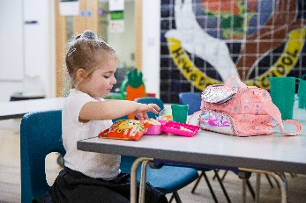
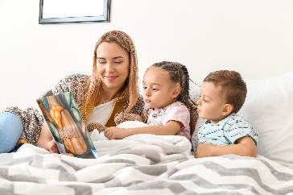
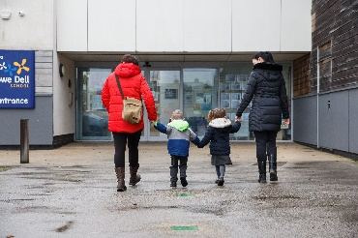
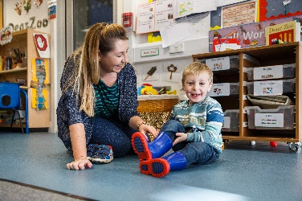
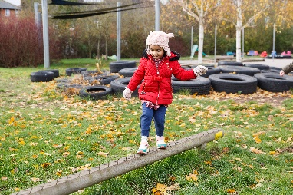


Keeping children safe is everyone’s responsibility
Notes:
Go through each point and give information on how parents/carers can help support the school to keep children safe
Children who are unwell – explain the school policy keep a child off school at least 48 hours after the last attack of vomiting and diarrhea (quote NHS guidelines) informing the school/setting regarding contagious/infectious illnesses
Medication –policy on administering medication (for example, antibiotics or paracetamol) parents/carers responsibility to inform the school if their child is taking or requires any type of medication.
Individual medical needs –vital for parents to share information about their child’s individual medical needs such as allergies so that a Health Care Plan (HCP) can be completed with the parent/carer
Explain the school’s/setting’s procedures and policy regarding the parent’s responsibility in alerting the school/setting if a child is absent or if they change address and contact details.

Slide 23
Smooth transition
Stay and Play - Thursday 10th July 9.00am – 10.45am
Home Visits – new to BG children only. 10th July (pm).
(You will be notified shortly of the time slot for your visit.)
Initial class allocations done before Stay & Play (subject to change)
Start date: Monday 8th September
9:30 a.m. – 2.30 p.m. all week

Slide 24
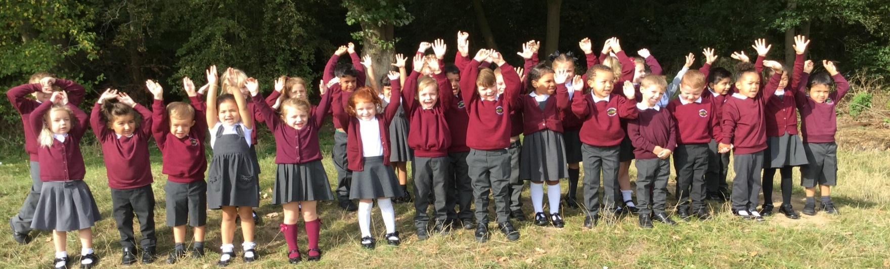
We look forward to working with you!
Please contact the school office if you need any further assistance or have any questions.

