Slide 1


Welcome to Bonneygrove Primary School Reception!

Slide 2
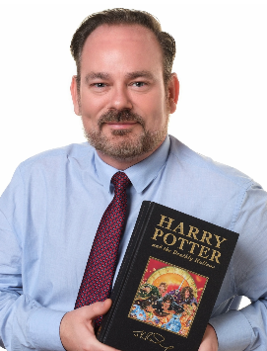
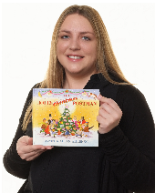
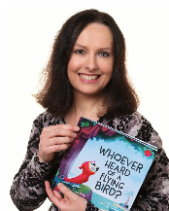
Bonneygrove Primary School Staff
Executive Headteacher
Mr Hamilton
Head of Inclusion
Miss Stevens
Early Years Lead
Mrs Photi

Slide 3
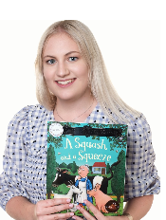
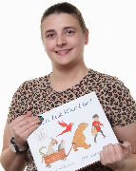
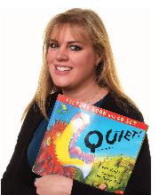

Bonneygrove Primary School Staff
Miss Morris
Reception Lead
Miss Laws
Reception Teacher
Mrs Nobrega
Reception TA
Mrs Kipkebut
Reception TA

Slide 4
What will my child be learning?
Prime Areas of Learning | Specific Areas of Learning
Personal, Social and Emotional | Literacy
Communication and Language | Mathematics
Physical Development | Understanding the World
 | Expressive Arts and Design

Slide 5
Reception Timetable
8.35 – 8.50 – Early morning activity as children arrive
8.50 – 9.00 – Register
9.00-9.30 – Phonics
9.30 – 9.45 – Guided reading
9.45 – 10.00 – Snack
10.00 – 11.00 –Child Initiated Learning
11.00-11.30 – Topic/ Talk for Writing
11.30-11.45 – Story / get ready for lunch
11.45-12.55 – Lunch time
12.55-1.00 – Register
1.00 – 1.25 – Maths
1.25 – 2.45 – Child Initiated Learning
2.45 – 3.00 – Phonics
3.00 – 3.15 – Story time
3.15 – Home time
Guided reading 3 x per week
PE / RE / PSHE/ Music / Visit to the woods once per week

Slide 6
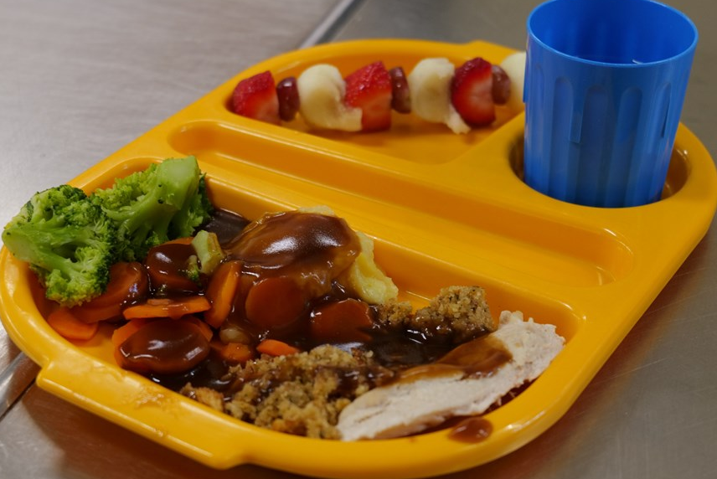
Lunch
Every child in Reception and KS1 is entitled to a free school meal.
You will receive a copy of the school dinner menu.
You will select your child’s lunch choices for the week on Arbor
Children will choose from a selection of vegetables or salad to accompany their dinner, along with a choice of dessert
We encourage children to use cutlery correctly from the beginning by supporting them to cut their own food. Mid-day supervisors are on hand to assist children.

Slide 7
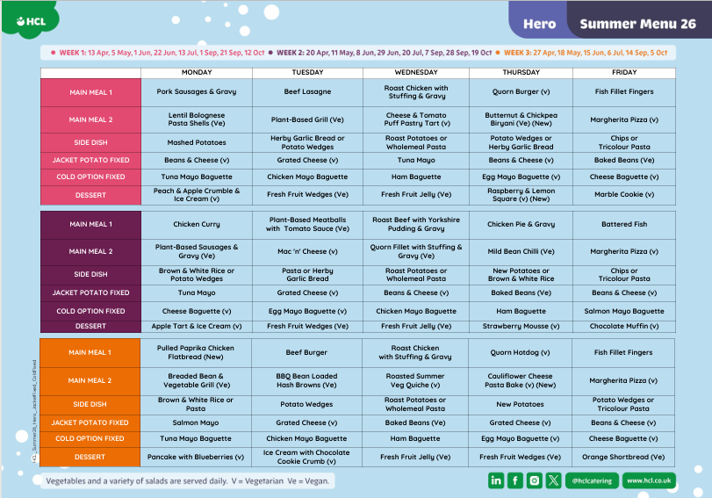

Slide 8
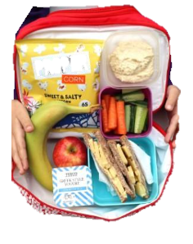
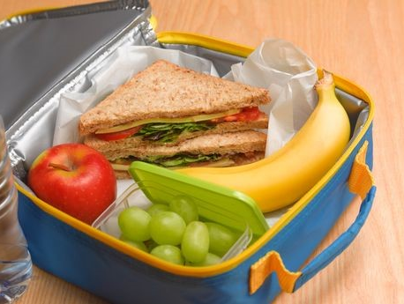
Packed Lunch
You can choose for your child to bring a packed lunch instead of a school dinner.

Slide 9

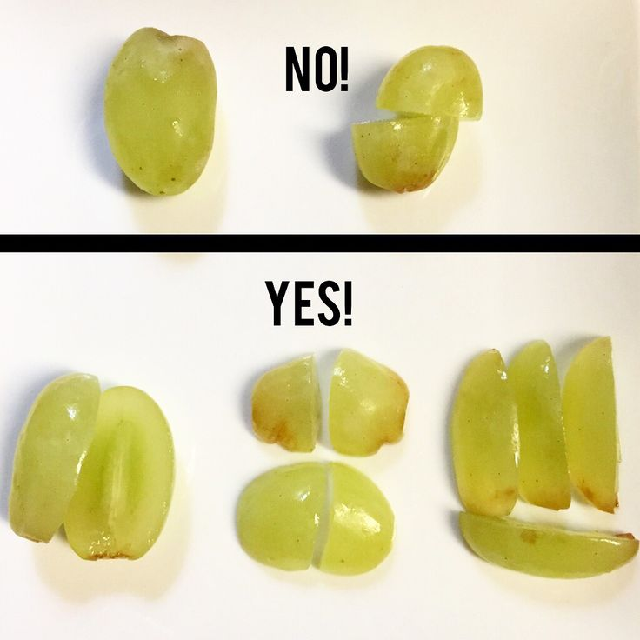



Slide 10
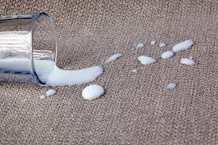

Allergies
Notes:
Child starting with a severe dairy and nut allergy.
Please do what you can to help keep them as safe as possible and minimise risks by ensuring that your child has finished their breakfast before entering school and that their uniform is clean and free from allergen. Please ensure that your child’s hands and face are clean before coming into school to avoid cross contamination and a possible reaction.

Slide 11
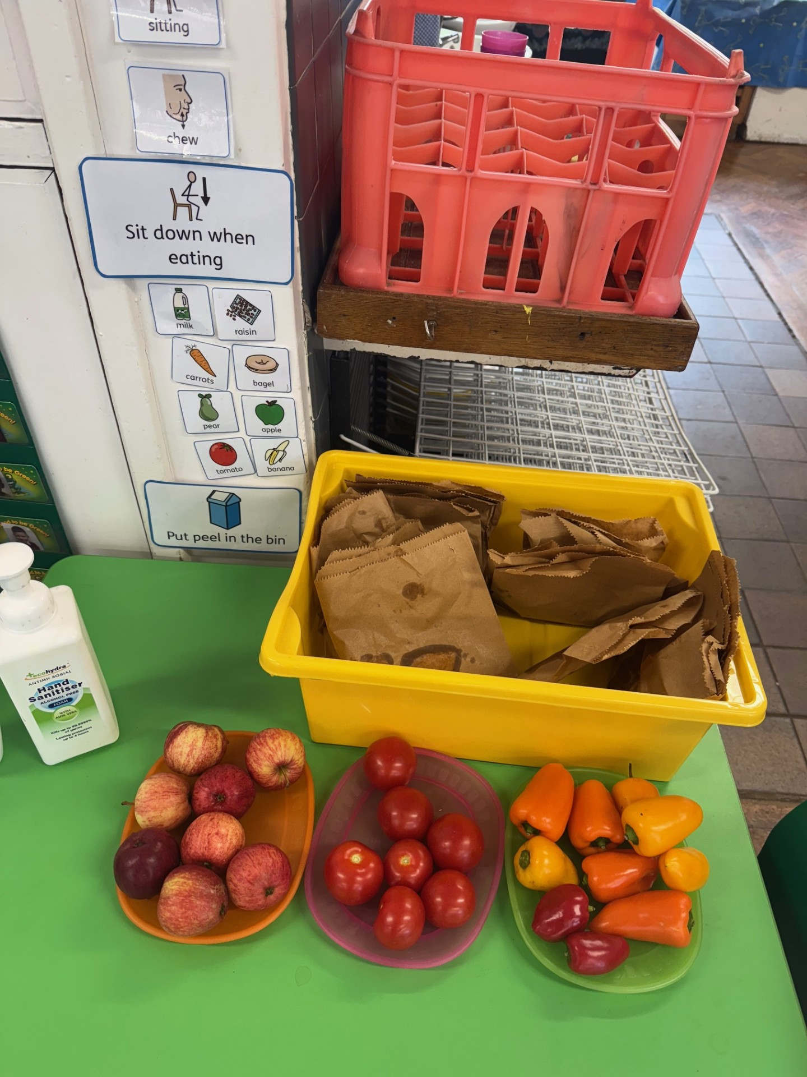
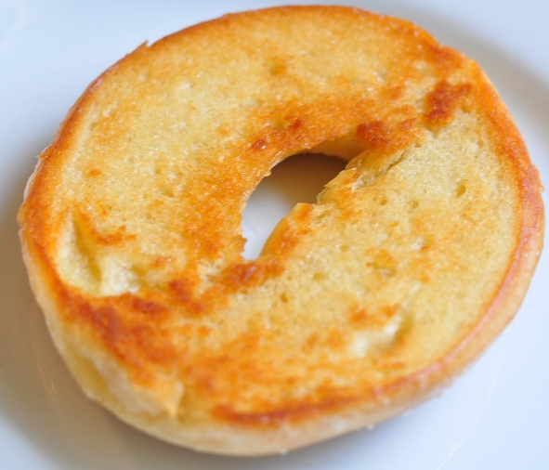

SNACK
Fruit is available daily
Bagels are available most days
Milk available and free to all children under 5 Years
(can be purchased after that)

Slide 12


Water bottles
Ensure your child has a NAMED water bottle with them every day.
These are available for children to help themselves throughout the day.

Slide 13
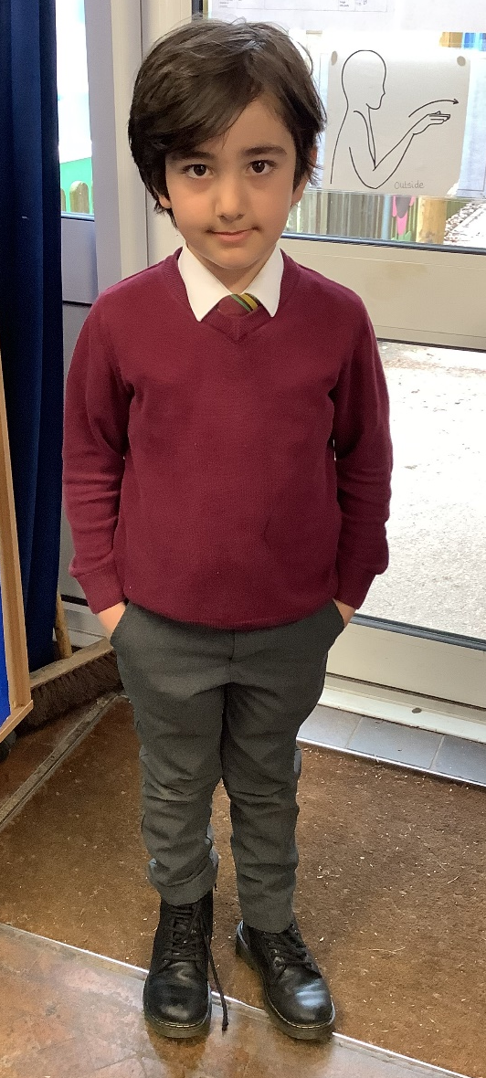
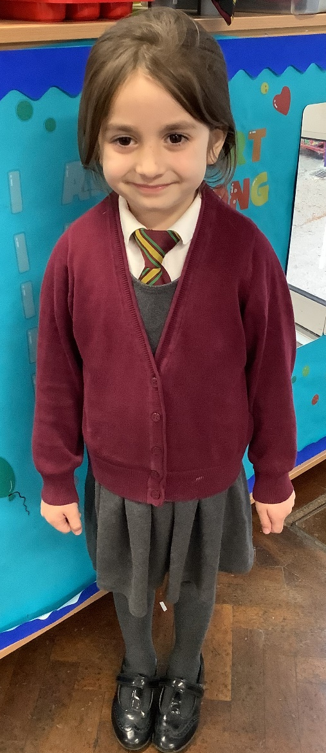
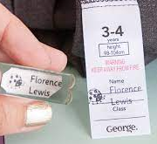
uniform
Burgundy v neck jumper or cardigan
Grey skirt/dress
Grey / black trousers / jogging bottoms
White long or short sleeved shirt with clip on tie
Black footwear
PLEASE LABEL UNIFORM

Slide 14
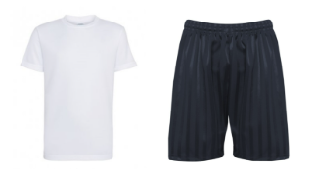
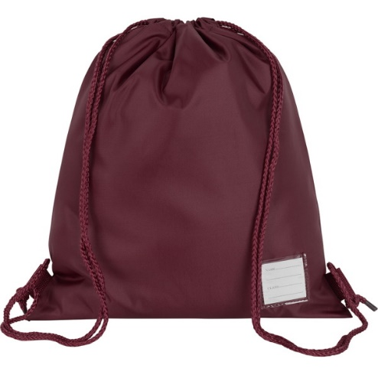
PE KITS
Plain white t-shirt,
black P.E. shorts,
trainers (Velcro please)
Winter: tracksuit bottoms
Provide P.E. kit in a labelled, draw string bag
– they will be returned half termly.
PLEASE
LABEL

Slide 15
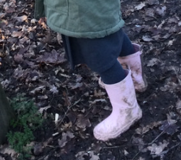

EXTRAS
Wellies - Please provide children with wellies that can remain at school as we encourage learning to be outdoors in all weather conditions. Suitable clothing expected to suit all weather conditions.
Book Bag (available to purchase from the school office) brought to school every day: key words, reading records + book, letters home, homework. Please no rucksacks!
Spare clothes- Please provide children with a bag of spare clothes that they can change into should they need to.
(INCLUDING UNDERWEAR)

Slide 16
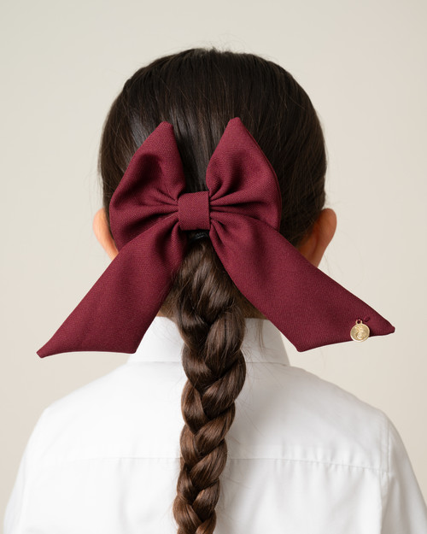
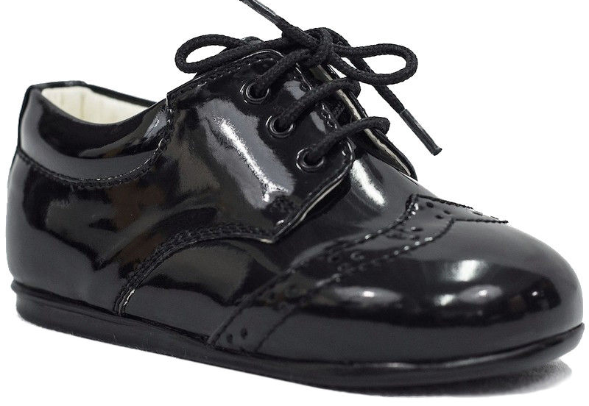
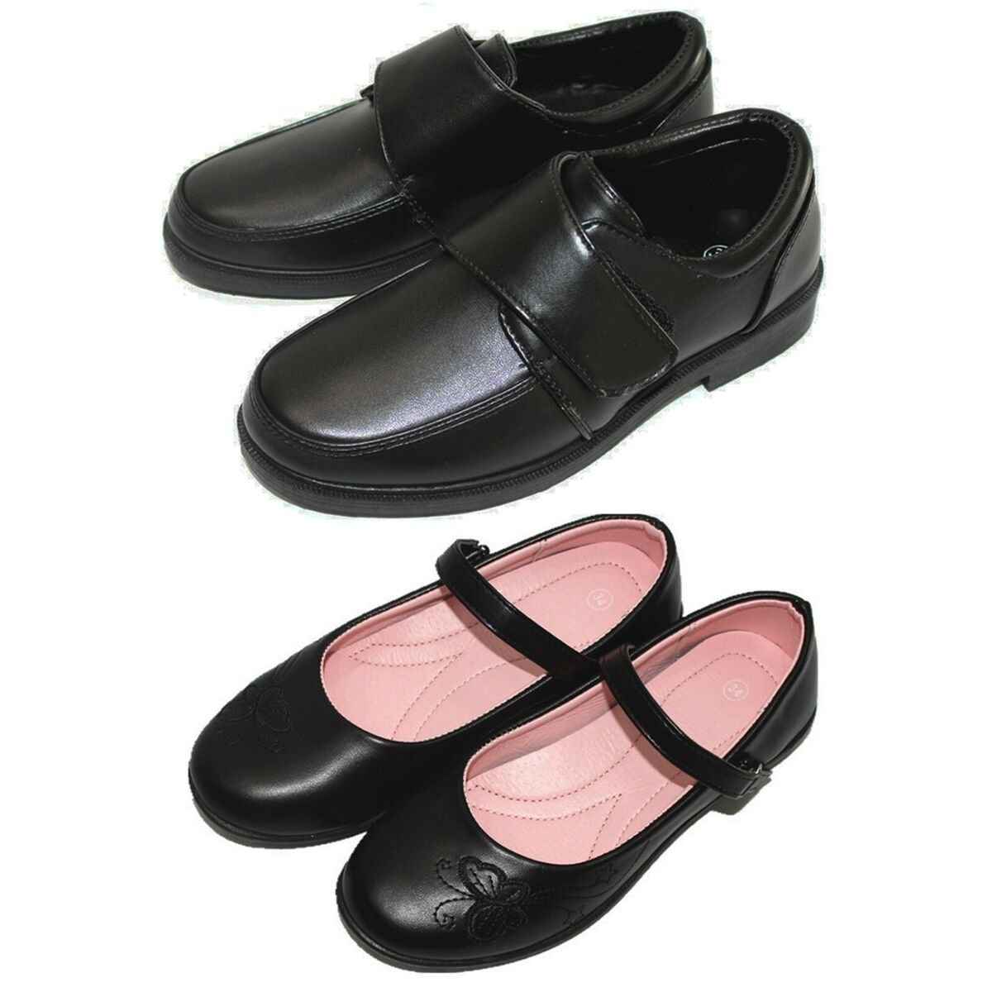

Hair – long hair tied back. Accessories: small bows, head bands to be in line with Bonneygrove uniform colour (burgundy).
Shoes- A sensible pair of hard-wearing school shoes. (Please no laces )
No laces please

Slide 17


Medical – asthma pumps must be in date; they will be stored in the classroom cupboard. An asthma History Questionnaire will need to be completed with the school office before the pump can be accepted.
Collecting children at home time. Children will not be sent home with anyone who is not on their ‘pick up list’, without permission from parent/ carer.
Arbor – a log in will be provided once your child is on Roll. Information and payments are made via this method.

Slide 18
attendance
We expect children to attend every day. It is important for young children to have a routine and experience all the activities on offer.
Holiday requests – please write to the Headteacher.
Absences - please call the office, before 9.00 a.m., if your child will be absent. If your child has an appointment, please let the office know in advance as you will need to sign your child in and out.

Slide 19
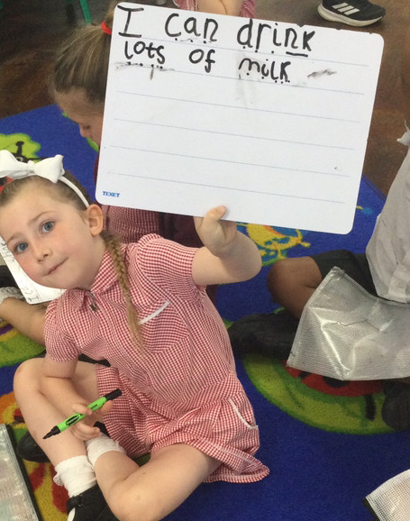
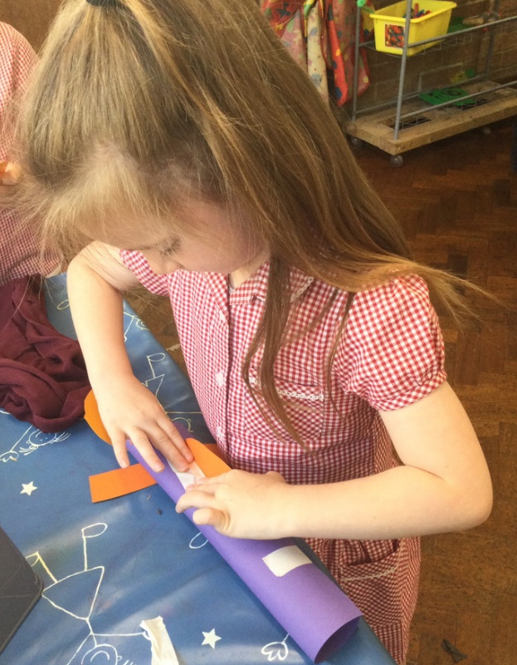
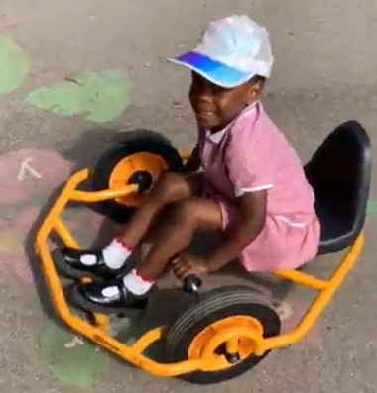

tapestry
Tapestry – online learning journals . Logins given at the end of term.

Slide 20
Parent Involvement
We like to welcome parents/carers into our classrooms as much as possible, so that you can see how your children learn first-hand! Sessions may include: phonics workshops, book bonanzas or themed days.
Reading record
Nativity – early December.
Trips and Visits
Two Parent Consultation sessions (Autumn/Spring)
Sports Day
End of year report
Communication is key – feel free to make an appointments to speak to your class teacher.

Slide 21
How we communicate with you
Communication is so important. It plays a huge role in ensuring that you are regularly sharing information with us to best support your child.
We do this by…
Daily chats at pick up time
Termly parent consultation meetings
Termly Newsletters
Notices on classroom window
Social Media – Facebook, Instagram (@ bonneygroveps)
Tapestry
School Website

Slide 22


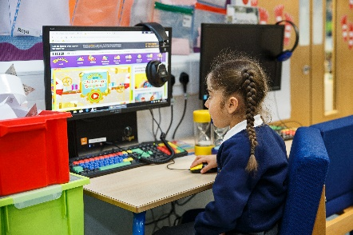
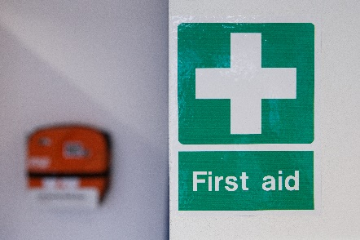
Keeping children safe is everyone’s responsibility

Slide 23
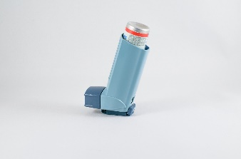

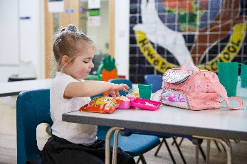
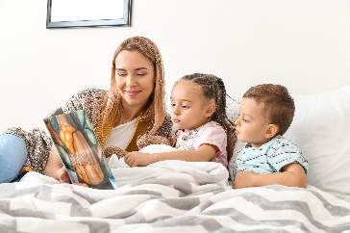
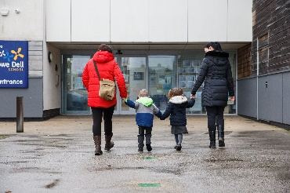
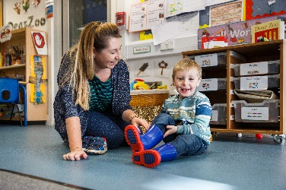
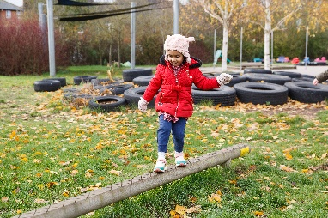

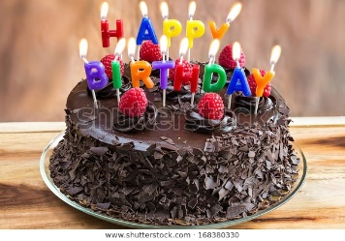
Keeping children safe is everyone’s responsibility

Slide 24
Smooth transition
Start date: Wednesday 2nd September
9:30 a.m. – 2.00 p.m. all week
8.35am – 3.15pm The following week as normal.

Slide 25
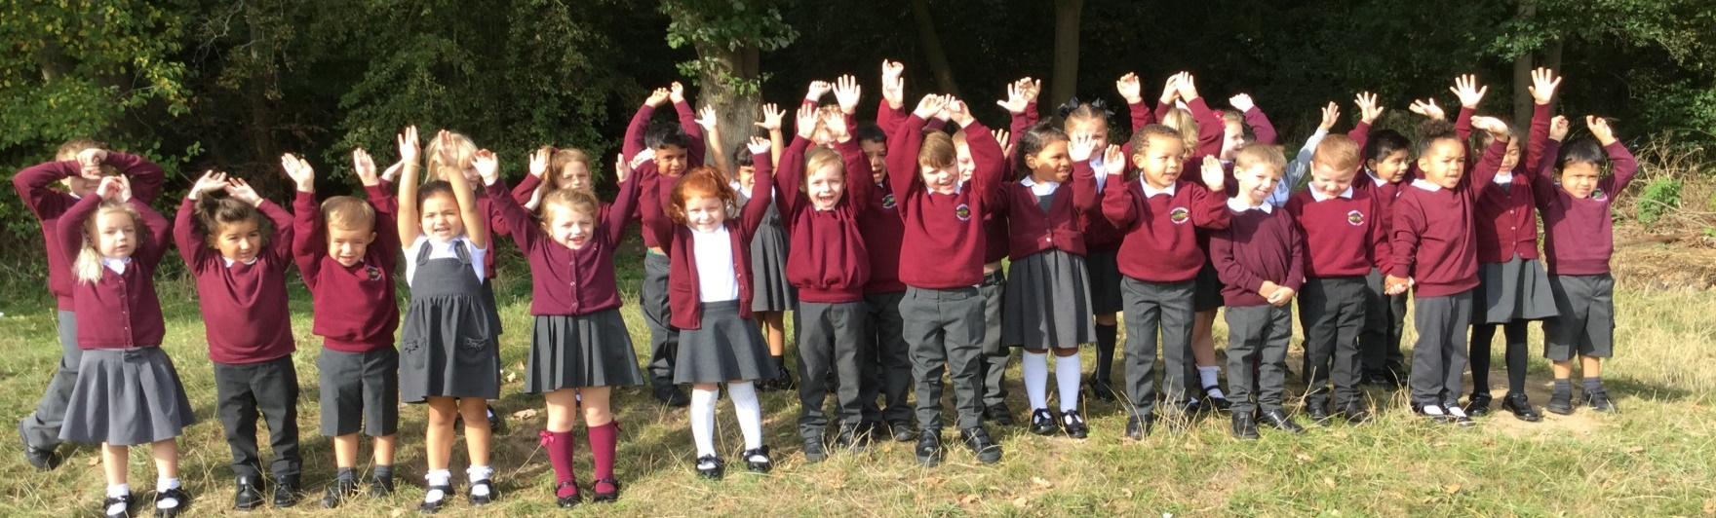
We look forward to working with you!
Please contact the school office if you need any further assistance or have any questions.

