Slide 1

What is the Year One Phonics Screening Check?
Bonneygrove Primary School
Headteacher: Mr Craig Hamilton BEd (Hons.), NPQH
A Guide for parents

Slide 2
The Year One Phonics Screening Check was introduced in 2012 as part of a policy to strengthen Phonics teaching in Primary Schools and reflect the emphasis on teaching it synthetically and systematically.

Slide 3
It normally takes place in June of Year One and usually administered on a one to one basis by a familiar adult.

Slide 4
During the screening children will be asked to read a list of 40 words to check their grapheme recognition and decoding skills. The words are made up of real words and non-words.

Slide 5
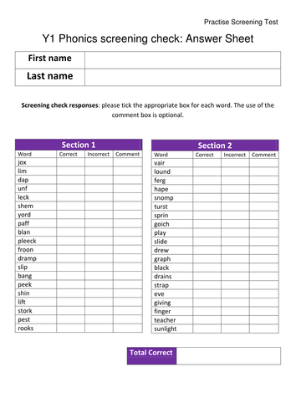

Slide 6
Reading non-words/alien words can act as a useful tool to check whether children are secure in their phonic knowledge and can apply it to read any word.
They check if children are using their decoding skills rather than relying on memorising words.

Slide 7
The check will normally be administered by a familiar adult in a familiar environment and usually takes less than 10 minutes. There is, however, no time limit so if children need more time they can have it.
There are 2 sections to the check
Section 1: words using graphemes from the earlier phases of Phonics including Phase 3 digraphs and adjacent consonants.
Section 2: words that contain Phase 5 alternative graphemes and split digraphs.

Slide 8
Each year the score that children need to achieve in order to pass the screening isn't announced until after the check has been administered.
Each year the score that children need to achieve in order to pass the screening isn't announced until after the check has been administered. For the past several years though the pass score has remained 32/40.

Slide 9
If children do not achieve the pass score then it is nothing to worry about. Teachers will be able to use the results to inform their planning, fill any gaps in children's learning and offer additional support.
Those children who don't pass the check will take it again in the Summer of Year Two.

Slide 10
How can I help my child prepare?
Share decodable books together and encourage them to segment and blend the words.

